Slide 1
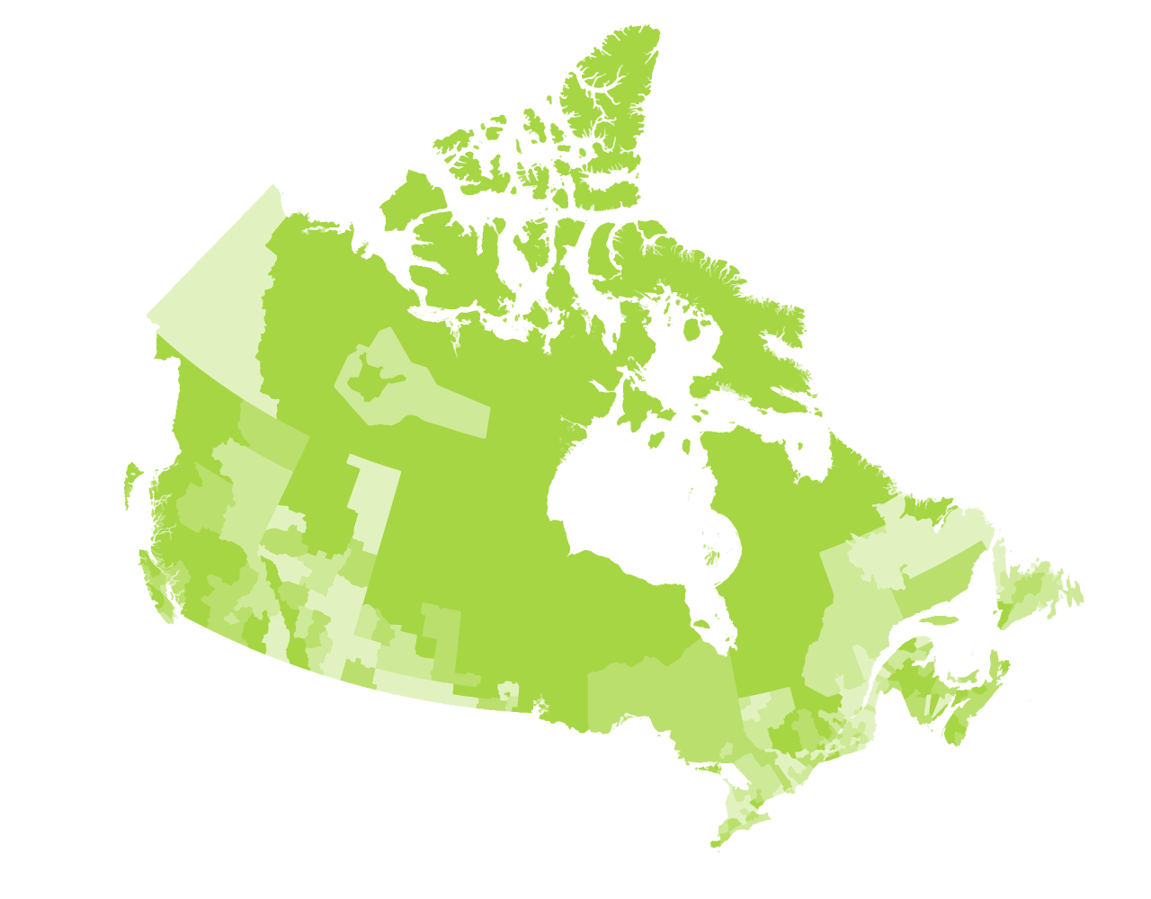
Solutions Lab
Community Decision Support Tool for Housing Issues
December 14th, 2021
Notes:
Sasha

Slide 2
Agenda
Vision for prototype
Moving forward with what we heard
Phase 5 and beyond
Notes:
Sasha

Slide 3
Solutions Lab Timeline
2 Mar. 2021
National Insight Generation Workshop
22 Apr. 2021
National Level Ideation Session
15 June 2021
National session to share ideas from local micro-labs
14 Sep. 2021
Prototyping activities workshop
16 Nov. 2021
Developmental Prototype: V.1 Suite of Tools
14 Dec. 2021
Draft prototype: Presentation
2 Mar. 2022
Lessons Learned Roundtable / Road map engagement session
31 Mar. 2022
1 Oct. 2020
SL Phase 1 kick-off
End of project
Notes:
Sasha

Slide 4
Prototype: Community Decision Support Tool for Housing Issues
Vision:
The Community Decision Support Tool for Housing Issues will offer credible and accessible data for local housing practitioners located anywhere in Canada.
The suite of tools will provide evidence-based answers to questions being asked locally across Canada.
Data accessed via the suite of tools will serve as one of many inputs to evidence-based housing-related local decision making.
Notes:
Sasha

Slide 5
Solutions Lab Successes to Date
Renewed and deepened focus on housing and homelessness as a priority theme
Capacity to structure large and diverse data sets based on common questions being asked at the community level across the country
New Partnerships emerging with CMHC, Canadian Alliance to End Homelessness, Centre for Rural Economic Development
Connecting with emerging best practices through other Solutions Labs and Housing Supply Challenge projects
Notes:
Michel

Slide 6
CDP’s Role in the Data Supply Chain: CDP as value-added wholesaler
Surveys & Admin Data:
Statistics Canada
Private providers
CMHC
IRCC
ESDC
Accessible Data Warehouse:
Focus on access to data
Custom tables at small geos
Data choice
Tableau as data access tool
Technical support
Localized products & tools
Housing Needs Assessment Tool
Rental Affordability Index
Housing Investment tool
Data Creators
Data Wholesale
Data Retail
Data acquired by CDP
CDP data products are inputs to data retail products
Designed by universities & consultants and/or contracted by local organisations
Data Consumers
Each member organisation’s needs are unique
CDP members possess varying data analysis capacities
Member organisations draw from CDP and other data sources, including in-house data
Members may work directly with data creators and data retailers
Notes:
Michel

Slide 7
Housing and Homelessness Data: CDP’s Approach
Benefits to the warehouse model:
One stop shop: All your data needs under one roof - no need to visit multiple sources to find what you’re looking for
Versatility: Data products are available in a variety of formats, so there is something for everyone
Relationships: CDP team is in direct contact with “data wholesalers” so will strive to order products that align with needs of housing practitioners
Member services: CDP team available to help members locate and transform data into compelling retail products
Census TGP
CDP’s Data Warehouse
Housing & Homelessness Portal
New Construction Survey
Pop. Estimates
Core-Housing Need
CMHC Rental Survey
2021 Census Products
Building
Permits
Notes:
Michel

Slide 8
Prototype Development – 4 key Building Blocks
1
Resources to support analysis
3
Data Advocacy
Community Decision Support Tool for Housing Issues
2
Data Access
& Visualization
4
Engagement & Outreach
Business Model
Notes:
Michel

Slide 9
What we heard during Phase 4 (high-level)
Wheelhouse Model is an appropriate framework for organizing data, but since it’s a model, there are some limitations
Practitioners want access to both Tableau products as well as original data table
Data for small area geographies is very important
Practitioners across the country have many of the same questions related to housing and homelessness
Local data and external housing and homelessness datasets can compliment the working being done in the Solutions Lab
Notes:
Sasha – present all four components

Slide 10
The Prototype: 4 building blocks

Slide 11
1. Resources to Support Data Analysis

Slide 12
Accessing the Housing & Homelessness Portal
Moving forward based on Phase 4 engagement:
Solutions Lab Portal to be renamed Housing and Homelessness Portal
Access point for all housing and homelessness related data and resources
https://communitydata.ca/content/solutions-lab-community-decision-making-tools-housing-issues

Slide 13
Data-related tools for data users
Moving forward based on Phase 4 engagement:
Access to a range of tools that support data analysis – i.e. access to Tableau products, IVT tables, excel tables
A platform for sharing best practices from other Canadian jurisdictions
E.g. UBC Hsg Supply Challenge - Housing Needs Assessment Tool; BCNPH Rent Index
Updates on webinars and community data news
Technical support – videos, past webinars, guides

Slide 14
2. Data Access & Visualization

Slide 15
Wheelhouse Model for Organizing Data
Moving forward based on Phase 4 engagement:
Safety Net Housing
Wheelhouse model used as framework for organizing data
“Housing with supports” renamed “non-market housing”
Wheelhouse model will include tab describing limitations of model for organizing data
Emergency Shelters
Short-Term Supportive Housing
Long-Term Supportive Housing
Ownership
Housing
Non-Market Rental Housing
Market Rental Housing
Non-Market Housing
Market Housing
Source: https://www.cmhc-schl.gc.ca/en/blog/2019-housing-observer/wheelhouse-new-way-looking-housing-needs

Slide 16
What We Heard: Priority Data Sets
Moving forward based on Phase 4 engagement:
Disaggregating housing demand data by CMHC priority demographic groups
Data for small area geographies
Intercensal data
Building a full picture of the local rental universe
Filling data gaps using data modelling and administrative data collection

Slide 17
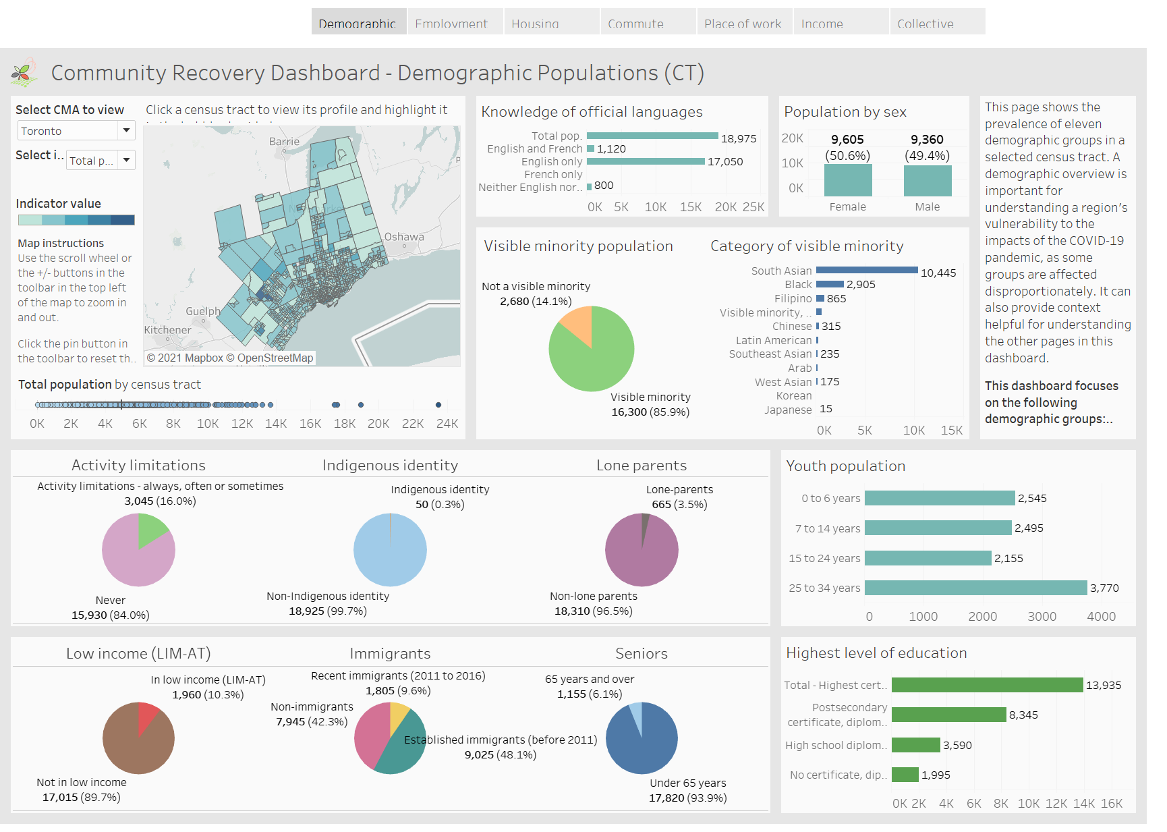
Data Visualization
Storyboard
Moving forward based on Phase 4 engagement:
Housing and homelessness data to be made available in the form of a Tableau dashboard – modelled after Community Recovery Dashboard
CDP will explore options for developing access tools for both PowerBi users and Tableau users
Data will also be available through a data access dashboard and in its original format
Dashboard

Slide 18
3. Engagement & Outreach

Slide 19
Engagement & Outreach
Moving forward based on Phase 4 engagement:
Focused on widening the Program’s reach to housing practitioners across Canada:
A cross-Canada Homelessness Community Data Network is under development in partnership with the Canadian Alliance to End Homelessness, proposal submitted to ESDC
Infrastructure Canada’s Centre for Rural Economic Development (CENRED) has agreed in principle to sponsor a Rural Community Data Network
CDP will be marketing its program to prospective municipalities in anticipation of the release of the 2021 Census

Slide 20
4. Data Advocacy

Slide 21
Data Advocacy
Moving forward based on Phase 4 engagement:
Advocacy efforts are focused on filling data gaps
Enabling access to new STC Housing Statistics Program
Working directly with CMHC to overcome limitations of CMHC data portal
Serving as a voice of CDP members regarding data issues
Statistics Canada being engaged via quarterly meetings as a bilateral forum for identifying data acquisition priorities
CMHC being engaged via a bilateral partnership agreement to develop customized data
CDP to regularly update members on new data

Slide 22
Underlying Business Model
Notes:
Michel

Slide 23
Business Model
Moving forward based on Phase 4 engagement:
Implementing the prototype and sustaining its development will rely on a three-part business model:
Core revenue stream will continue to be based on the membership-based Community Data Consortium
Project-based grant funding will enable further development of the prototype
An expanded fee-for service Community Analytics could be designed to recover costs of investment in refining data visualizations
Notes:
Michel

Slide 24
Next Steps: Phase 5 and beyond
Notes:
Michel

Slide 25
Phase 5 and Post-Project
Phase 5 - January 1st – March 31st, 2022
Dissemination of user survey
Completion of Solutions Lab Roadmap
Final report to CMHC to be submitted
Develop a Demo version of Housing and Homelessness Dashboard & Storyboard in Tableau
Roundtable Event: March 2nd – 1:30 - 3:00 pm ET
Final Solutions Lab session: March 8th -1:30 – 3:00 pm ET
Post-April 1st, 2022
CDP committed to developing Housing and Homelessness Dashboard as part of 2022 program budget
Housing and Homelessness Data Portal to be launched (with support of ESDC, funding pending)

Slide 26
Access to Project Resources & Data
Moving forward beyond March 31, 2022
Materials developed during the Solutions Lab project will be made available to CDP members and non-members
Data products developed after post-Solutions Lab project will be available to members only
Non-member organizations are encouraged to become members of an existing consortium or to establish a new consortium
Notes:
Michel

