Slide 1
Community Decision Support Tool for Housing Issues
September 14th, 2021

Slide 2
Team Introductions
Notes:
-Updates – time to share issues, challenges, and opportunities

Slide 3
Agenda
Team Introductions
Micro-lab Updates
Project Review
Prototype Development
Problem Statement
Project Timeline
Prototype Showcase
Review of 7 priorities & 4 emerging building blocks
Community Decision Support Tool for Housing Issues
Data Access & Visualization
Engagement and Outreach
Data Advocacy
Business Model
Next Steps
Notes:
Workshop Goal: To showcase the four prototypes and clarify role of micro-labs in prototype development.

Slide 4
Micro-Lab Updates
Notes:
-Updates – time to share issues, challenges, and opportunities

Slide 5
Project Review
Notes:
-Updates – time to share issues, challenges, and opportunities

Slide 6
Prototype Development & Updates from other Solutions Labs
Type
Rapid
Slow
Probing
Exploratory
Developmental
Incremental
Evolutionary
Exploratory Prototype:
An early form of prototype, usually a visualization of a concept or idea, tested to determine whether it warrants further development and testing in the field.
Spectrum of prototype development
Notes:
- Segway into how we are going to run the session

Slide 7
Timeline
2 Mar. 2021
National Insight Generation Workshop
22 Apr. 2021
National level ideation session followed by micro-labs engagement of local stakeholders ideation sessions
15 June 2021
National session to share ideas from local micro-labs & confirm prototyping approach
14 Sep. 2021
Prototyping activities workshop
9 Nov. 2021
Developmental Prototype: V.1 Suite of Tools
7 Dec. 2021
Developmental Prototype: V.2 Suite of Tools
8 Feb. 2022
Lessons Learned Roundtable / Road map engagement session
8 Mar. 2022
Sharing project results and transition to post-project implementation

Slide 8
Objectives of today’s session
Review the project & 7 key priorities
Showcase the four building blocks - building blocks reflect what we have heard and our progress to date.
Each building block is associated with a set of discussion questions. We will provide time for initial reactions now, but questions will be included as part of the information package for further consideration.
Outline next steps for micro labs and prototype development (Information package)

Slide 9
Solutions Lab Challenge Brief
Solutions Lab Challenge Brief:
Municipal governments and community-based organizations want to make decisions based on relevant, credible data. Planners, managers and analysts also recognize that community-level programs demand good data and a capacity to learn from detailed program results.
Currently, decision-makers may see housing data as the 'black-box' domain of specialists in academia, data management, or policy think tanks. They may also come to see some types of interventions as inherently more reliable in delivering desired policy results on the ground simply because measurements of outputs, e.g., units delivered, seem clearer and are routinely produced for them.
Unless there is deep and widespread real-time accessibility of a diverse range of outcomes-focused housing data, indicators, and decision guidance, risks of systemic failure will persist. That is the core decision-making problem to be addressed by this project.
In sum…
The value of relevant, credible data for informing strong program and policy design is widely recognized by decisions makers.
However, there is a narrative that housing data is inaccessible; over reliance on narrow range of housing indicators
Therefore, there is an immediate need to generate a diverse range of housing related information that is widely accessible to local decisions makers.

Slide 10
Prototype Showcase
Notes:
-Updates – time to share issues, challenges, and opportunities

Slide 11
7 Key Priorities
Conceptualizing housing data via the lens of a measurement framework: assessing current and potential indicators
Filling data gaps
Developing data access and visualization tools to meet a spectrum of local data analysis capacity
Reaching more local decision-makers
Data advocacy: sustained engagement of Statistics Canada and CMHC
Offering time-tested data-related tools to CDP members
Funding the resulting roadmap: building on existing revenue streams and exploring new ones

Slide 12
Prototype Development – 4 key Building Blocks
1
3
Data Advocacy
Data Access
& Visualization
Community Decision Support Tool for Housing Issues
2
4
Engagement & Outreach
Business Model

Slide 13
Prototype: Community Decision Making Tool for Housing Issues
Purpose & Solution to Challenge Brief:
Offer credible and accessible data sources for local housing practitioners located anywhere in Canada to serve as one input to strengthen evidence-based housing-related decisions.

Slide 14
Prototype: Community Decision Making Tool for Housing Issues
Designed to answer the following questions:
What is the state of the local market housing stock?
What is the state of the rental housing stock?
What are local population trends? (population growth/decline/ immigration)
What are the characteristics of houses/households in core housing need? (by tenure, structure, age, condition of rental housing, accessory rental housing, subsidized rental housing, owned homes, condominiums, by CMHC priority groups)
How is the housing stock changing?
How does the housing supply affect CMHC priority groups?
What type of housing supports are available?
Are there any other housing related question to be answered by the prototype?

Slide 15
1. Data Access & Visualization

Slide 16
Housing Data Framework
Questions for today and to bring to micro-labs:
Does the housing wheelhouse make sense as a model for organizing data?
Do the variables identified here help to fill housing data gaps?
Will this data help to answer housing related questions in your community?
Are there any other questions we should be asking as a group?
Is there anything missing?

Slide 17
Role of Data Access and Visualization in prototype development
Access to range of data users & decision makers
Identify priority data sets
Participant &
user feedback
Organize data around “wheel house model”
Design tableau dashboard

Slide 18
What We Heard: Priority Data Sets
1. Disaggregating housing demand data by CMHC priority demographic groups
2. Building a full picture of the local rental universe
3. Filling data gaps using data modelling and administrative data collection
Notes:
Allow time for feedback → check in about further data gaps

Slide 19
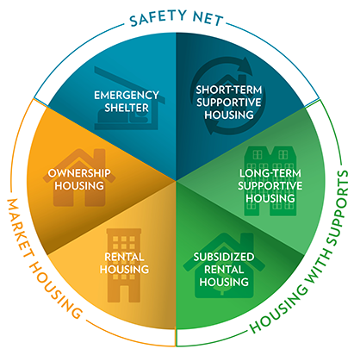
Wheelhouse Model for Organizing Data
Source: https://www.cmhc-schl.gc.ca/en/blog/2019-housing-observer/wheelhouse-new-way-looking-housing-needs
Notes:
- John to add more context

Slide 20
Household Characteristics
Variable | Source | Year | Description
Population growth | Pop estimates | 2010-2020 | Population growth, age cohorts (seniors, older seniors, working age, children), immigration growth
Immigration | IMDB | 2012-2019 | # of immigrants by intended destination Retention rate
The priority groups by affordability | Census | 2016 | Selected priority groups (Low income, indigenous, racialized (disaggregated), seniors, recent immigrants, activity limitations) By in/not in core housing need (by component - affordability, adequacy, suitability) Data Gaps: Indigenous disaggregated by First Nations. Inuit, Metis; Veterans. To be addressed in 2021 census

Slide 21
Market Housing – General Characteristics
Variable | Source | Year | Description
The Housing Stock | Census | 2016 | # dwellings # households Tenure breakdown Age breakdown Condition of housing # of rentals Average house price
Change in stock | Building permits | 2016-2020 | # of units, by type New construction Conversions Demolitions Renovations
Change in stock | CMHC New Housing Construction Survey | 2010-2016 | Housing starts by dwelling type and intended market Housing completions by dwelling type and intended market See: CDP-CMHC data sharing schedule - CDP request (CMHC edits)

Slide 22
Market Housing – Rental Housing
Variable | Source | Year | Description
Rental Housing Stock | CMHC Rental survey | 2010-2020 | # of rental units by bedroom type, row/apartment type, year of construction, structure size Vacancy rate by bedroom type, row/apartment type, year of construction, structure size, rent ranges, rent quartiles Average and median rents, by bedroom type, row/apartment type, year of construction, structure size See: CDP-CMHC data sharing schedule - CDP request (CMHC edits) Data gaps: Annual rental data for smaller CSDs to be modelled

Slide 23
Market Housing – Rental Housing
Variable | Source | Year | Description
Rental Housing Stock | CMHC Secondary Rental Market Survey | 2016 | % of units by bedroom type Vacancy rate by bedroom type Average rent by bedroom type See: CDP-CMHC data sharing schedule - CDP request (CMHC edits) Data Gaps: Basement apartments, Short-term rental, Seasonal rental; Secondary rental for smaller communities

Slide 24
Market Housing – Rental Housing
Variable | Source | Year | Description
Rental Housing characteristics by priority populations | Census | 2016 | Total Units Tenure, age, condition, average rent, average house price BY Priority groups in/not in core housing need (low income, indigenous, racialized (disaggregated), seniors, recent immigrants, activity limitations) Data Gap: Indigenous disaggregated by First Nations. Inuit, Metis; Veterans)

Slide 25
Market Housing – Ownership Housing
Variable | Source | Year | Description
Cost of Homeownership | CMHC New Housing Construction Survey | 2010-2020 | Absorbed unit prices by quintile and dwelling type Average, median and price percentiles for absorbed homeowner and condominium units Average housing price for new build versus existing

Slide 26
Market Housing – Ownership Housing
Variable | Source | Year | Description
Cost of Homeownership | CMHC New Housing Construction Survey | 2010-2020 | Absorbed unit prices by Quintile and dwelling type Average, Median and Price Percentiles for Absorbed Homeowner and Condominium Units Average housing price for new build versus existing
Housing characteristics Among Homeowners by priority populations | Census | 2016 | Tenure, age, condition, average rent, average house price BY Priority groups in/not in core housing need (low income, indigenous, racialized (disaggregated), seniors, recent immigrants, activity limitations) Data Gap: Indigenous disaggregated by First Nations. Inuit, Metis; Veterans)

Slide 27
Housing with Supports – Long-term supportive housing
Variable | Source | Year | Description
Supportive long-term housing | CAEH | TBD | Based on emerging partnership with CAEH

Slide 28
Housing with Supports – Subsidized Rental Housing
Variable | Source | Year | Description
Subsidized rental housing | CMHC Social and Affordable Housing Survey | 2019 | # Units by rent threshold, by bedroom type Average rent/counts by rent range by administrative body
Subsidized housing characteristics by priority populations | Census | 2010-2020 | # of rental units by bedroom type, row/apartment type, year of construction, structure size Vacancy rate by bedroom type, row/apartment type, year of construction, structure size, rent ranges, rent quartiles Average and median rents, by bedroom type, row/apartment type, year of construction, structure size Data gaps: Annual rental data for smaller CSDs to be modelled

Slide 29
Safety Nets – Emergency Shelter
Variable | Source | Year | Description
Emergency Shelter | CAEH | TBD | Based on emerging partnership with CAEH

Slide 30
Safety Nets – Short-term Supportive Housing
Variable | Source | Year | Description
Supportive short-term housing | CAEH | TBD | Based on emerging partnership with CAEH

Slide 31
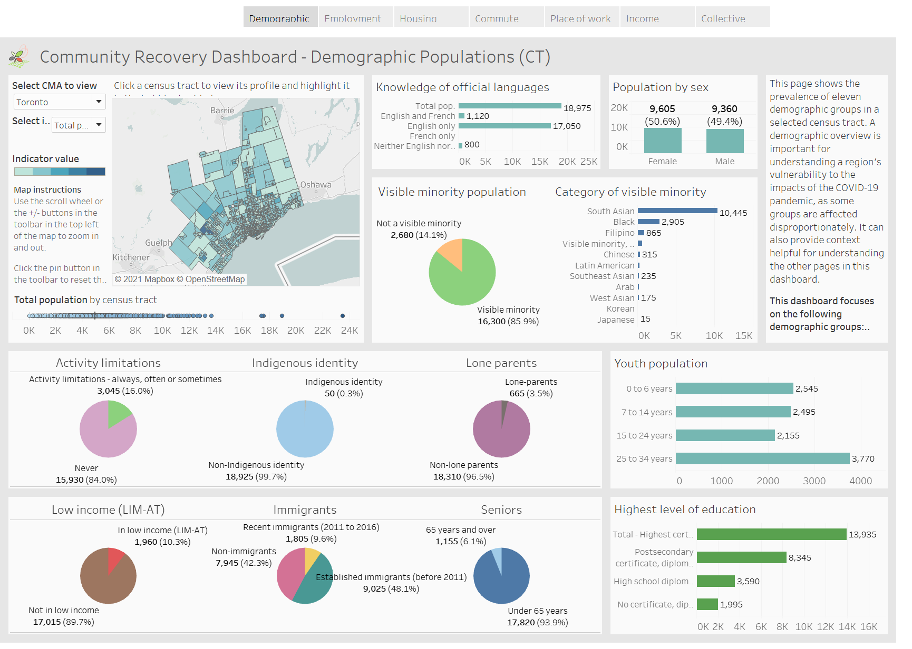
Data Visualization
Dashboard
Storyboard

Slide 32
Data Visualization
Dashboards
Storyboard
Designed to support housing decisions
Organized around wheel-house model
Based off complex, multi-dimensional data sets
Can generate datasets and graphics
Detailed, disaggregation of housing data. Ability to compare between communities; detailed overview of single community
User completes analysis; time consuming and user must have some capacity for data analysis
Able to toggle between variables and customize to unique circumstances
Auto-populated suite of graphics; easy to use regardless of data capacity
Provides quick, easy to understand snapshot of community
Based on a set of predetermined indicators; no ability to customize

Slide 33
Accessing the Housing Portal
Solutions Lab Housing Portal
https://communitydata.ca/content/solutions-lab-community-decision-making-tools-housing-issues

Slide 34
Data Visualization
Questions for today and to bring to micro-labs:
How would you like to use the housing decision support tool?
What type of data visualization style aligns with your organization’s capacity?
Notes:
Dashboard – link will be provided, survey with set of question, participants to play with dashboard following meeting, what questions are we asking of participants?
Playbook for meeting

Slide 35
2. Engagement & Outreach

Slide 36
Engagement & Outreach
Emerging partnership with Centre for Rural Economic Development (CENRED) to create rural data portal
Emerging partnership between CDP and Canadian Alliance to End Homelessness (CAEH)
Concept note submitted to Employment Social Development Canada (ESDC)
Working with other Solutions Labs
Exploring collaborations with provincial municipal associations in BC, AB, SK
Notes:
Description of prototype
Interact
Building partnerships → heard it was important, first step to acquiring data → what type of ongoing engagement would be useful, explore different types of engagement and outreach, what can people do at local level to engage

Slide 37
Extent of Engagement & Outreach
CDP engaging national organizations
Communications package to be delivered to build capacity of micro-labs to engage local data providers
Are there any other national organizations that could be engaged?

Slide 38
3. Data Advocacy

Slide 39
Data Advocacy
CDP as intermediatory between local communities & data providers to fill data gaps
Quarterly meeting with Statistics Canada & communications with Housing Statistics Program
CMHC & CDP Data Swapping Agreement
Focus on filling priority data gaps (such as rural housing data)
What are the top priorities for data advocacy?
Notes:
Data advocacy – Role CDP plays in accessing data for membership – specific types of data
Advocacy happens at different scales – provincial / federal

Slide 40
4. Business Model

Slide 41
Business Model
Community Data Consortium Membership model as foundation
Expand Community Data Network consortium model (not place based)
Adjust pricing to reach rural communities
Fee for service – Building and interpreting complex data products beyond the lifetime of the Solutions Lab
Is your organization’s capacity reflected within the business model?
Notes:
Who is willing to participate?
Allow for feedback first

Slide 42
Next Steps

Slide 43
Next Steps
Information package by October 1st
November 9th session – check in on phase 4
December – target end of testing phase
January – March – Phase 5: Finalization of prototype & roadmap
Notes:
Next steps for each of the prototypes

