Slide 1
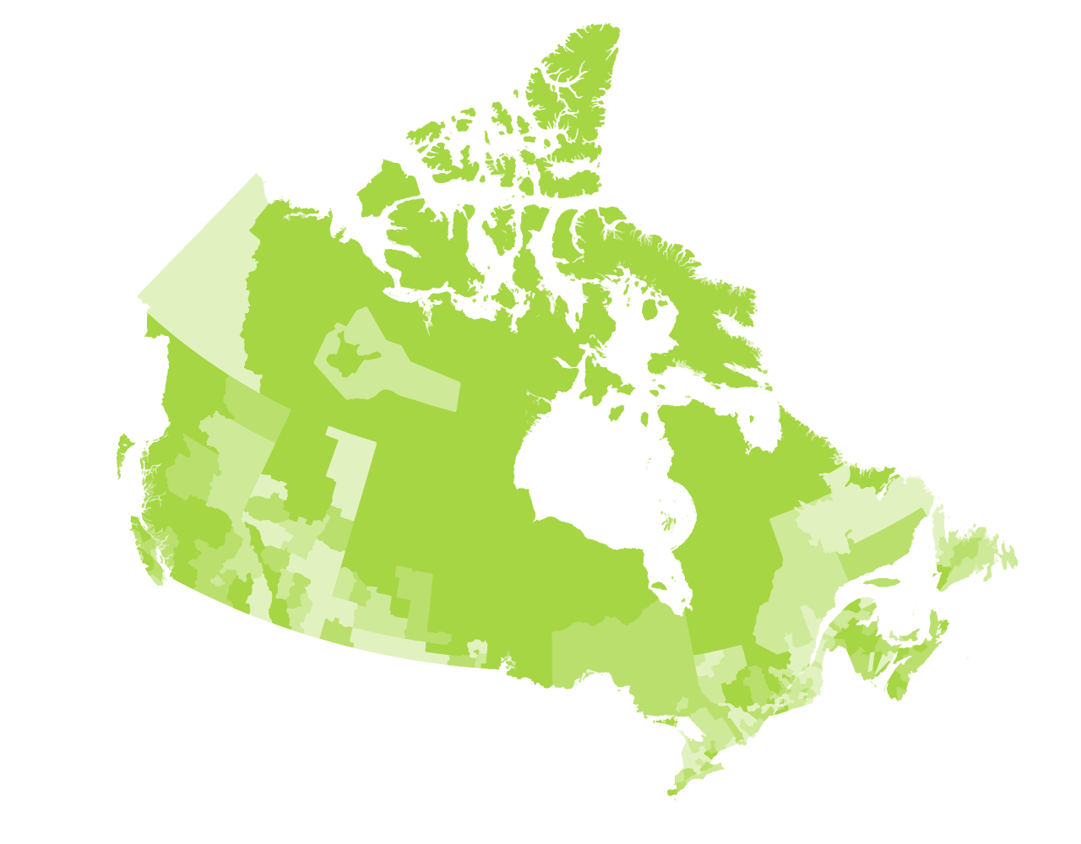
Beyond 20/20 Orientation with Q&A
Tuesday, December 5, 2023, 1:30 pm to 3:00 pm ET
Presented by Michael Ditor, Senior Analyst Community Data Program

Slide 2
Agenda
Live demo on how to use Beyond 20/20
Arranging dimensions
Showing/hiding items
Exporting data in other formats
General questions

Slide 3
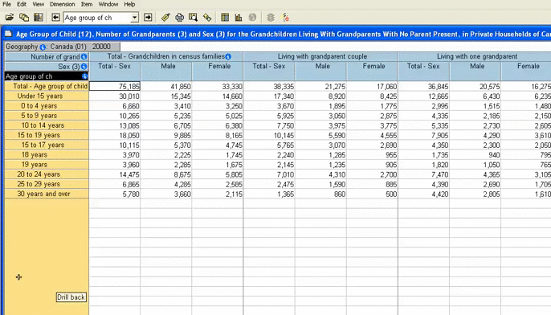
Beyond 20/20
What to use it for:
Access most of the data tables available in the CDP catalogue
StatsCan software
Can be used to manipulate multi-dimensional tables and zero in on the data you need before bringing data into excel

Slide 4
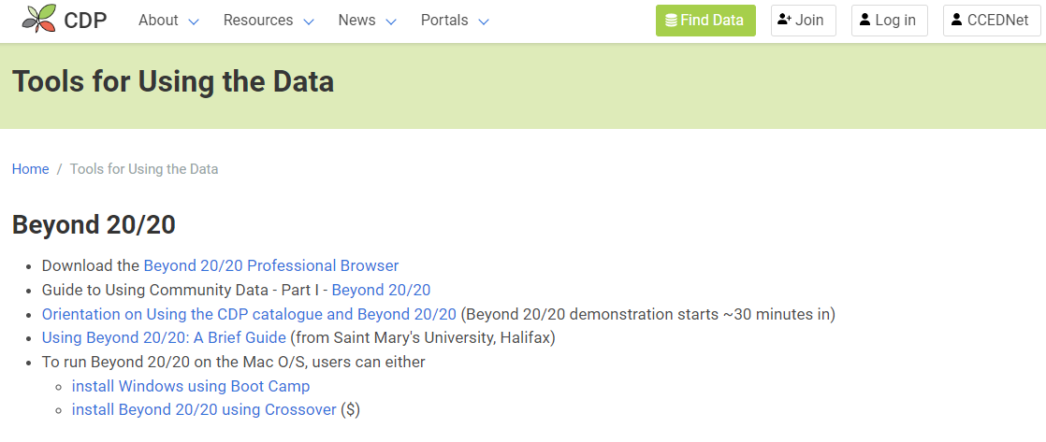
Want To Download Beyond 20/20 Software & Guide? Check out our Beyond 20/20 Resources on the CDP Website

Slide 5
Thanks for listening!
Contact us any time with questions.
www.communitydata.ca
information@communitydata.ca
Notes:
Sasha

