Slide 1
Visualizing Data: Loading CDP data into ArcGIS Pro
Graham Wilson, Spatial Planner – Growth Management
Community Growth and Economic Development Department
Notes:
Thank you Sadie!
Hi Everyone,
My name is Graham Wilson, and I’m a Spatial Planner at the Regional Municipality of Durham, in the Community Growth and Economic Development Department.
I’d like to talk to you today about visualizing data, and show you how to load data from the Community Data Program into ArcGIS Pro.

Slide 2
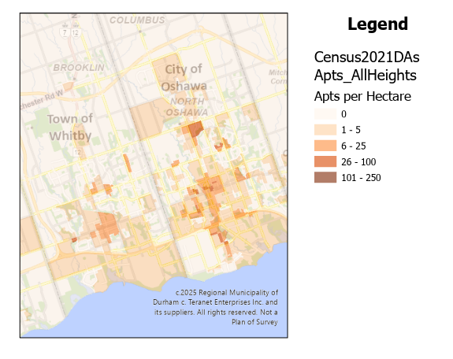
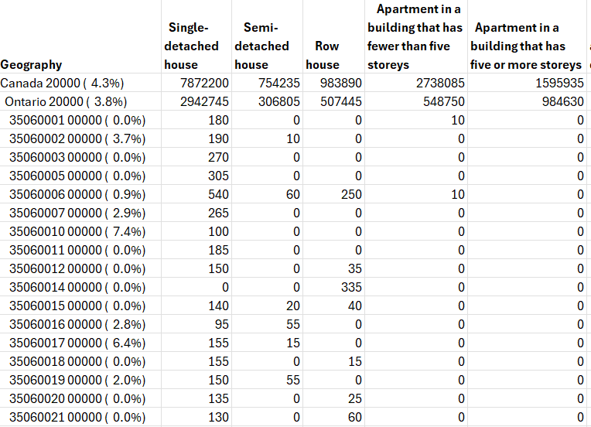
Why Visualize?
Imagine: you just got your data from CDP, and you want to show off your results.
Notes:
Why is it important to visualize data?
I’d like you to imagine a scenario that you just got your custom Census order from CDP, and you’re really excited by the results and by what it says about your community.
How would you communicate that to other people who aren’t as familiar with the data?
*click*
You could show them the data table itself, which is often how we received the data. This may be good for doing analyses or comparisons, but it’s not easy for our eyes to take in, especially when it’s a big table. For example, this table has over 1000 rows. In addition, there’s no easy way to show which row represents which area, without adding a bunch of extra location columns.
*click*
If we show it on a map, we might not be able to show as many different attributes, but it can be a lot easier to understand, and also to see patterns. This is a choropleth map of apartment density. On this map, it’s easy to see that there’s more apartments per hectare in Central Whitby, and even more in Oshawa, clustered along a north-south street. And if you’re from the area, you’ll recognize some of the clusters as Downtown Oshawa, Oshawa Centre Mall, and Durham College / UoIT. You might even notice outliers like the White Oaks apartments in West Whitby, which stands out as a small block of towers in a sea of low-density housing.

Slide 3
Simple Steps to make a basic Choropleth Map
Outside ArcGIS:
Find your Data
Prepare your Data to show the attributes and dimensions you want
Arrange your Data in a tabular form, including a key for joining
Inside ArcGIS:
Find your Geography
Add your Data as a table
Join the Data to the Geography
Explore your Results!
Notes:
I’m going to show you simple steps to make a basic choropleth map, which is a map of different shaded polygons over a geographic area.
First, we’re going to find and prepare the data outside of ArcGIS:
We need to find the data we want, and
prepare it to show the attributes and locations we want.
Then we need to arrange the data into a table that has 1 row for each of our locations, and a column that we can join to the geography layer in ArcGIS.
Then, we’re going to go into ArcGIS Pro and:
Find the geography we need,
Add our data as a table in the ArcGIS project
Join the data to our geography, and
Explore the results!
I’m going to jump in and out of the presentation to show you some of the workflow as we go. Please feel free to interrupt me if you have any questions.

Slide 4
1. Find your source data
Start Here: Find Data | The Community Data Program
Make sure it matches available geography
If it’s custom geography, you need the same geographies
Example: Housing and Demographics by Dissemination Area
Age of primary household maintainer (15), Structural type of dwelling (10), Condominium status (3), Household type including census family structure (16), Statistics (3C), Tenure (4) for Private households, 2021 Census — 25% Sample data | The Community Data Program
Geography: includes Dissemination Areas (DAs)
Crosstabs: Household Type
Notes:
First, find your source data.
For example, why not start by looking in the Community Data Program?
Make sure that the data you find matches the geography you have. If it’s custom geography, you need the same shapefiles that you submitted to CDP.
For this example, I found a table of housing and demographics by Census Dissemination Area from CDP. I made sure that it had the dimensions and data that I wanted; in this case I want to show how many dwellings there are in each area, by the different structural types of dwelling, like townhouses vs apartments.

Slide 5
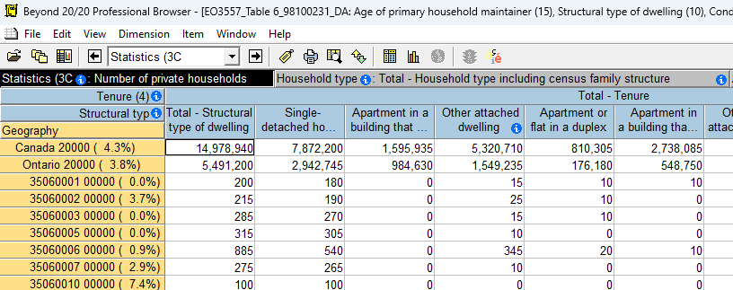
2. Preparing Data in Beyond 20/20
Flat (denormalized) table:
1 row per geography
All dimensions across the top
Example below: Total Number of Private Households by Tenure and Structural dwelling, by Geography (Dissemination Area)
Notes:
Next, prepare your data in Beyond 20/20, if it’s an .ivt file.
My goal here is to make a flat or denormalized table that has all the attributes I want across the top, and a row for every geography along the side.
You can use Beyond 20/20 to arrange and drill into the different dimensions, but I wanted to keep everything to the totals and just show the number of dwellings by tenure (the top blue row) and by structural type (the second blue row).
Now I’ll jump into Beyond 20/20 and show you an example
*open .ivt file*

Slide 6
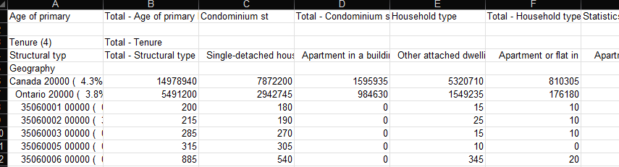
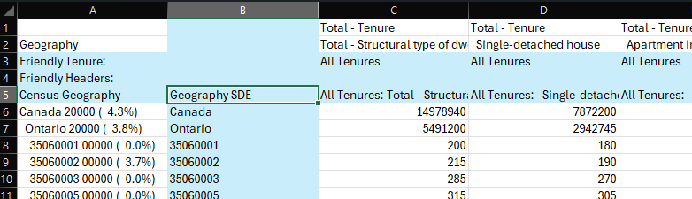
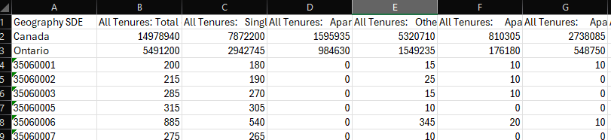
3. Preparing Data in Excel
Save as .xls or .csv file
Prepare a row of “friendly headers” and a column of “friendly geographies” that matches the format of your shapefile IDs
Copy values to a fresh sheet with no extra header rows
Notes:
Now we need to prepare the data in excel.
First, export the data as a .xls or .csv file, and open it to explore it.
*click*
You can see that the table will show extra information at the top about the other dimensions in the table, as well as a row for both the dimensions I want. This might make sense here, but it’s not how ArcGIS needs the data.
*click*
First you’ll need to make a single header row, in this case by simplifying and concatenating the other dimensions. This can be as simplistic as you like, as long as no two are the same.
Second, you’ll need to make sure that there’s a column which just has the IDs of the geographies you want. I’m using a layer of Dissemination Areas where the ID is just the DA number, but stored as text.
*click*
Then, hide or clear out the old headings and any working rows you had, and you’re ready to import. Note that this table just has one row of headers across the top, and one row for each different DA.
Now I’ll jump into Excel and show you how I would do it.

Slide 7
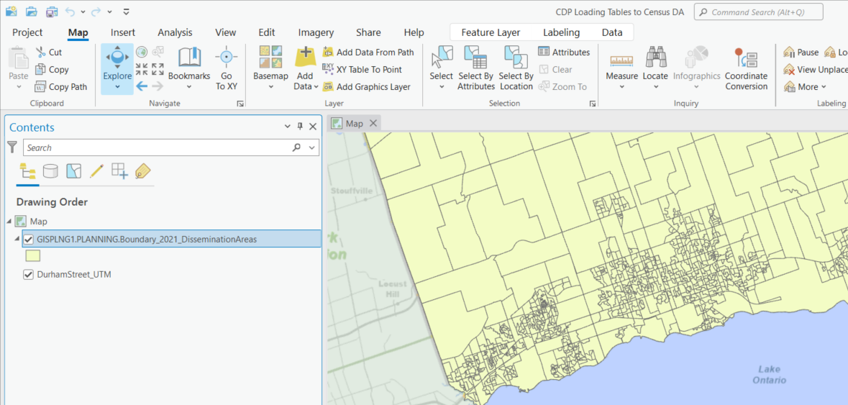
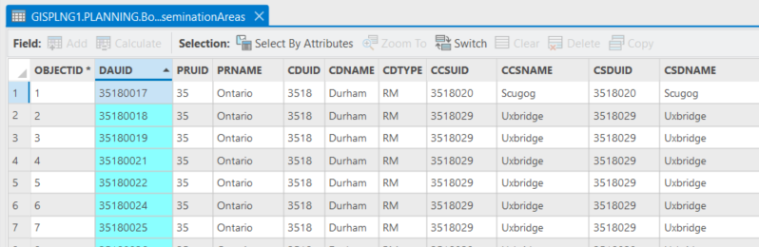
4. Find your Geography in ArcGIS Pro
Make a new project in ArcGIS Pro
Find and add your Feature Layer (Durham Census Dissemination Areas, in this case; see also Census Boundary files)
Intro to ArcGIS Pro: Introducing ArcGIS Pro—ArcGIS Pro | Documentation
Explore the attribute table to confirm the ID will match what’s in your Census table (format, too!)
Notes:
Now we’re going to open ArcGIS Pro and find our geographies.
I started by making a blank new Map project, but you can also import them into an existing one.
Hopefully you have your geographies already, but here’s a link to some Census Boundary files if you need it.
*click*
First, add the feature layer to the map, and make sure it’s what you want. I see Dissemination Area boundaries in my area of interest, Durham Region.
*click*
Next, explore the attribute table to confirm that the shape ID will match the way you have it in the data table from CDP. In this case, the DAUID column is showing 8-digit numbers formatted as text, which is the same as my data table.
I’ll jump into ArcGIS Pro here to show you how.

Slide 8
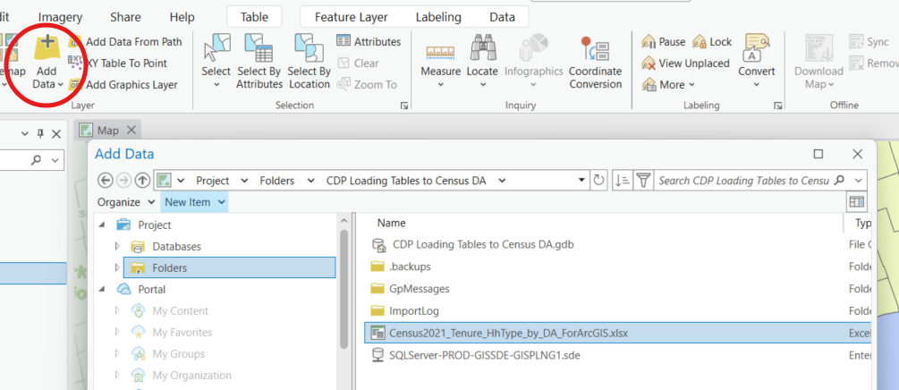
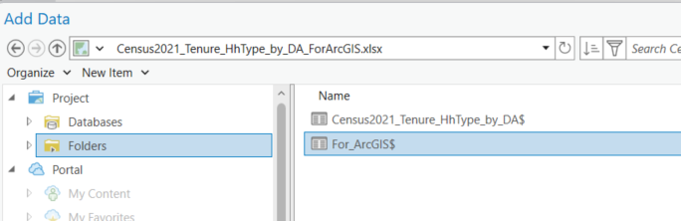
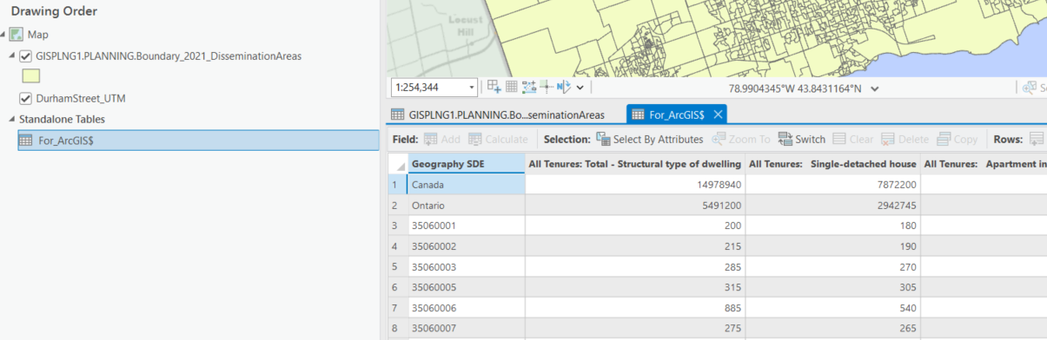
5. Add the Census Data table to the project
Use the Add Data button to navigate to your Excel file
Make sure you load in the proper table!
Open the table in ArcGIS Pro to make sure it came in properly
Notes:
Now we’re going to add the census table to the project.
*click*
First, use the add data button and find your excel file. Navigating folders in ArcGIS pro can be weird, so I usually just copy the file path and drop it in to speed things up. You can also save the table in the ArcGIS Pro Project folder.
*click*
Make sure that you add the right table! If you have an excel file with a few different tabs, or different named table ranges, make sure you pick the one you actually want. Here I gave myself instructions by naming the table range “For_ArcGIS”.
*click*
Next, open the table in ArcGIS pro to make sure it came in properly. Check to make sure that the attribute names are what you want, and that the Geography attribute will work. Here I see my DA IDs are 8-digit numbers formatted as text, so that’s good. The extra rows like “Canada” and “Ontario” are OK, as they won’t get joined.
I’ll jump into ArcGIS Pro and show you how.

Slide 9
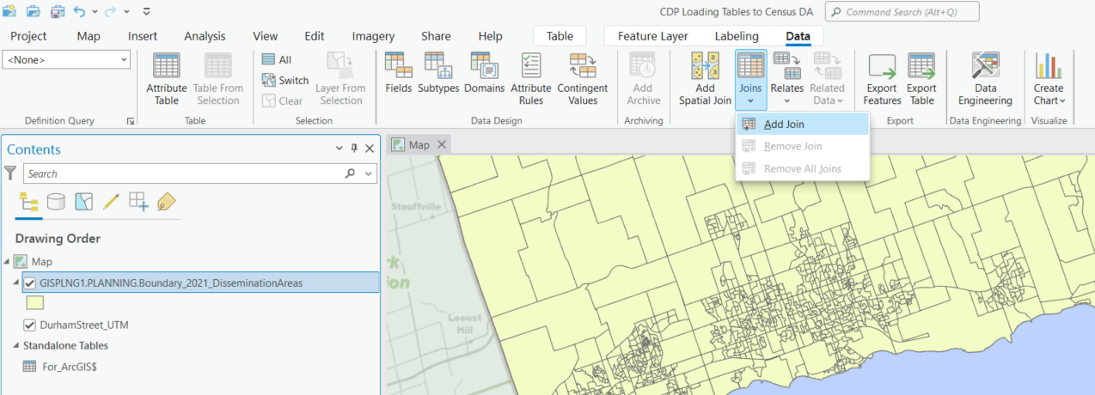
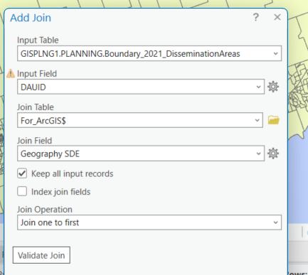
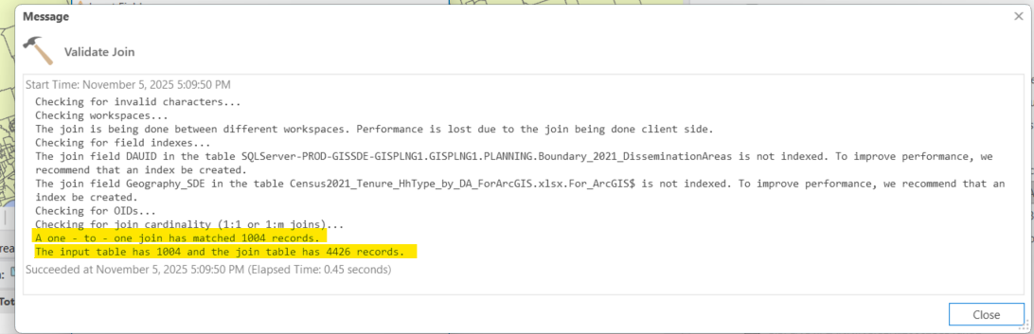
7. Join the Table to the Feature Layer
Start from the Feature Layer and Add a Join
Select the field / column in both tables that have the DA ID
Validate first to see if there are errors
Notes:
Now let’s join the two together!
*click*
It’s important to start from your feature layer of geographies, otherwise it won’t show up. Select the layer and add a join.
*click*
Now you have to select the table you want to join, and make sure that you select the fields that have the geographic ID key. Validating the join is a good idea to make sure the join will be succesful. Now you can run it.
*click*
Here’s the message output, and you can see it says that it joined 1004 records. This is good, because my input table has 1004 rows, so that means it found something for all of them. You can see the join table had many more rows. This is a reminder to make sure that’s what you were expecting. If the table is really big, find a way to filter it down to the geographies you want before you bring it into ArcGIS.
I’ll jump into ArcGIS here and show you how I do it.
*ArcGIS – show how to load and join

Slide 10
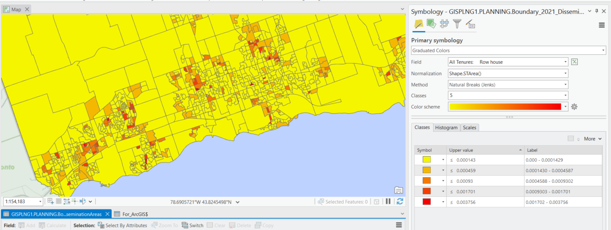
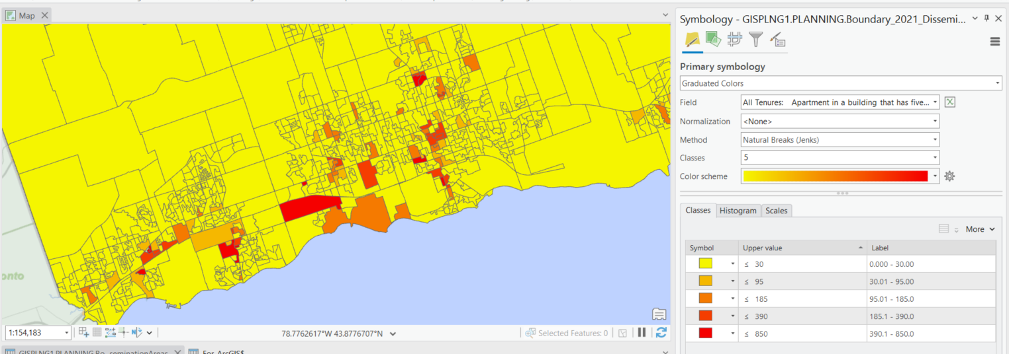
8. Explore your Results!
The Census data fields will now show up in the Feature Layer table
You can use Symbology to show Choropleth maps!
Bonus points: Normalize by an area measure to show density!
Notes:
Now it’s time to explore your results!
The census data fields will now show up as attributes in the feature layer table!
*click*
Now use the symbology tool, pick “graduated colours” for a choropleth with a numeric attribute, and see what your data tells you! Here, I can see how many apartment dwellings are in each dissemination area across the Durham Lakeshore.
*click*
For bonus points, use the normalization dropdown to normalize the results by area, and you will see the results as density instead of raw numbers. This is good for when you have features with widely differing sizes, like urban vs rural dissemination areas. Here I can see the density of row houses across the Durham Lakeshore.
Now I’ll jump into ArcGIS and show you how I would do it.
*ArcGIS - visualize

Slide 11
There’s So Much More to Explore!
There are many ways to visualize and explore data; this was just one!
Try exploring different visualization options and analytical tools to do more with your data and tell compelling stories.
Pay attention to how to visualize your data; other people might not see it the same way you do!
Resources:
Mapping and visualization in ArcGIS Pro
Urban Data Analytics, Visualization, and Storytelling – Urban Data Analytics, Visualization, & Storytelling 📊📈🏙️
Notes:
Please note, that was just a simple demonstration and a simple visualization. There is so much more to explore!
There are many ways to visualize and explore data, both in ArcGIS and in other tools.
Try exploring different visualization options and analytical tools, to do more with your data and tell compelling stories. This can include non-map tools like charts and graphs. And sometimes, all you need really is just a simple table.
Remember to pay attention to how you visualize your data, because other people might not see it the same way you do. Beware of accidentally showing something as “bad” or “undesirable”, or accidentally painting a whole neighbourhood in a negative light.
Here are some resources to help you. Esri has a lot of good tutorials for how to do this stuff; and that’s how I learned! Also here’s an online textbook about urban data analytics; I’m taking a course in this through UofT now, and it’s been eye-opening.

Slide 12
Thank You!
Graham Wilson
Spatial Planner – Growth Management
Community Growth and Economic Development
Notes:
That’s my presentation. Please feel free to ask me anything.
Thank you for your time!

