Slide 1
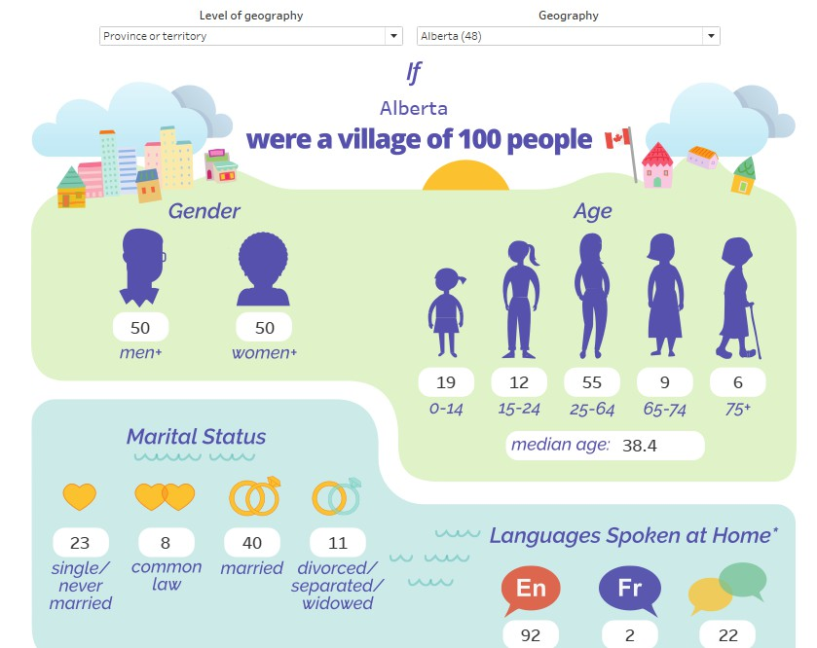
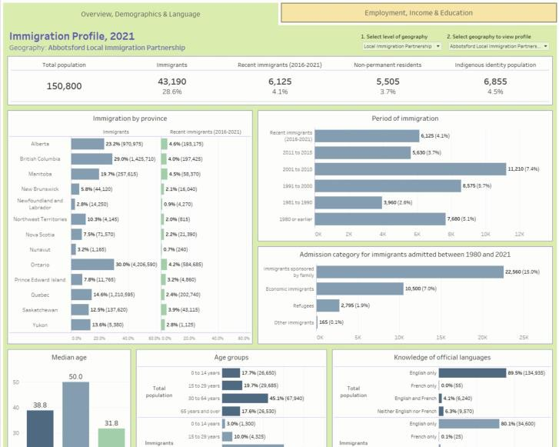
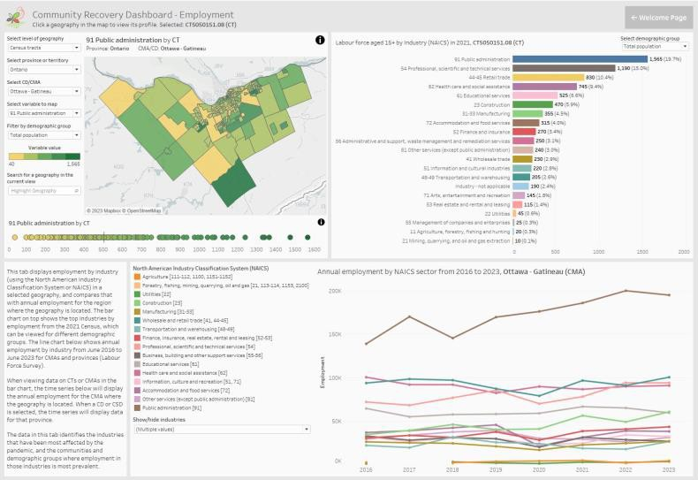
Orientation to the Community Data Program’s Tableau Infographics and Dashboards
By August Tensuda
august@communitydata.ca
information@communitydata.ca

Slide 2
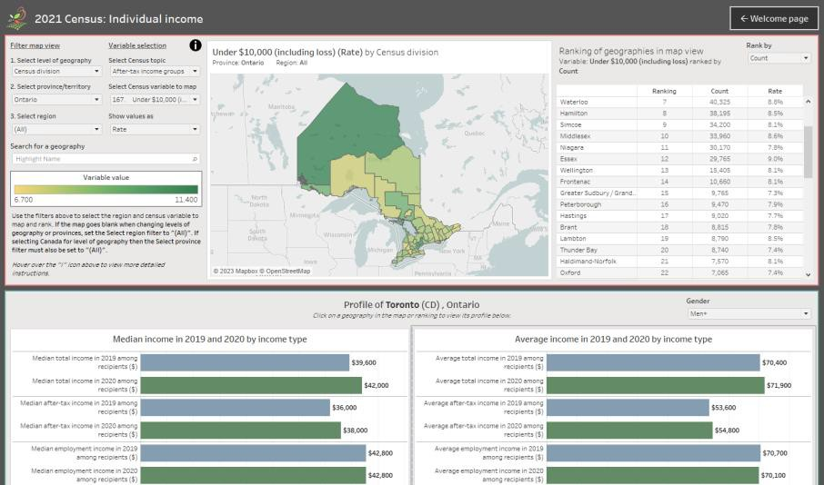
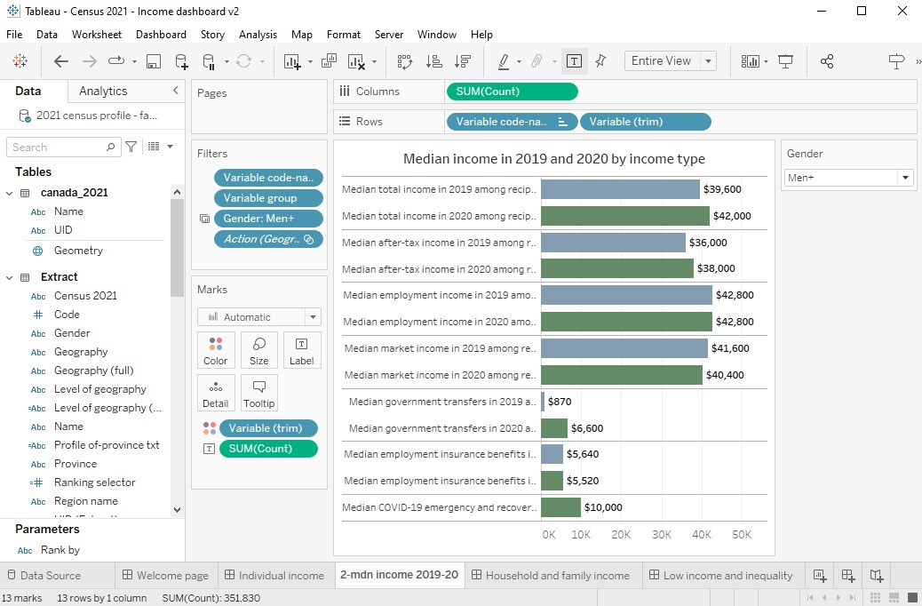
What is Tableau?
Data visualization and analysis platform
Software for building and sharing interactive infographics and data tools (dashboards)

Slide 3
Versions of Tableau
Tableau Desktop
Premium Tableau software used to create dashboards
Requires annual or monthly subscription fee (“Creator”
subscription)
Available at a discount for non-profit organizations through TechSoup
Includes Tableau Prep
Tableau Public
Free software for creating dashboards, sharing and embedding online
Offers most of the functionality of Desktop with a few key limitations:
Limit on number of rows in data sources
Dashboards must be saved to the cloud where they become publicly available. Anyone with the link can view and share it.
Tableau Reader
Free software used to open and interact with Tableau
Dashboards
Opens Tableau Packaged Workbooks (.twbx files)
Can’t be used to create or edit dashboards
How we intend for CDP members to use our dashboards
Other versions of Tableau for sharing dashboards:
Mainly for organizations sharing dashboards internally
Monthly or annual fee
Only registered users with “Viewer” subscription can view dashboards
on Tableau Cloud
Tableau Embedded Analytics
Significant cost, dependent on factors such as number of users
Secure, customizable embedding with support from Tableau
Tableau Cloud

Slide 4
Tableau for CDP members
Creating Tableau Dashboards for CDP members, with
goal of reaching “Modest Capacity Users”
Growing library of dashboards available in the CDP catalogue
Dashboards present data from the Census and other sources, covering all of Canada at varying levels of geography
Tableau training and support for CDP members

Slide 5
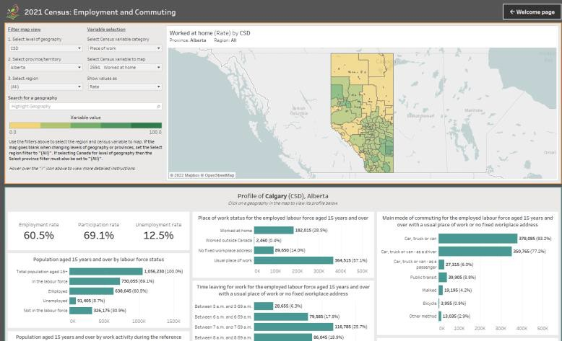
CDP’s dashboard library
Over 40 dashboards currently available in the catalogue
Interactive Infographics
Immigration Profile Dashboard, 2021
Village of 100 Dashboard, 2021
Themed Dashboards
Community Recovery Dashboard
Housing Dashboard
Analytical dashboards visualizing CDP datasets
IMDB ICARE Dashboard
2021 Census Profile Dashboards
And more..

Slide 6
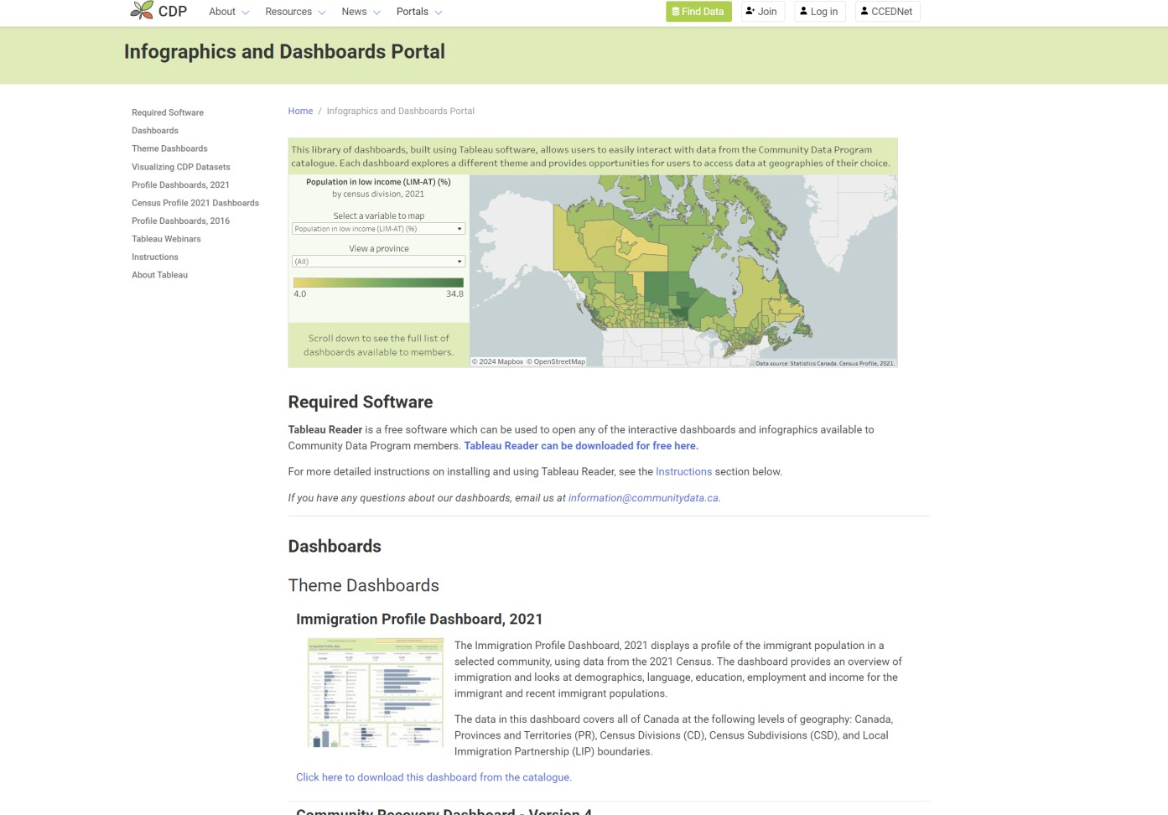
Infographics and Dashboards Portal

Slide 7
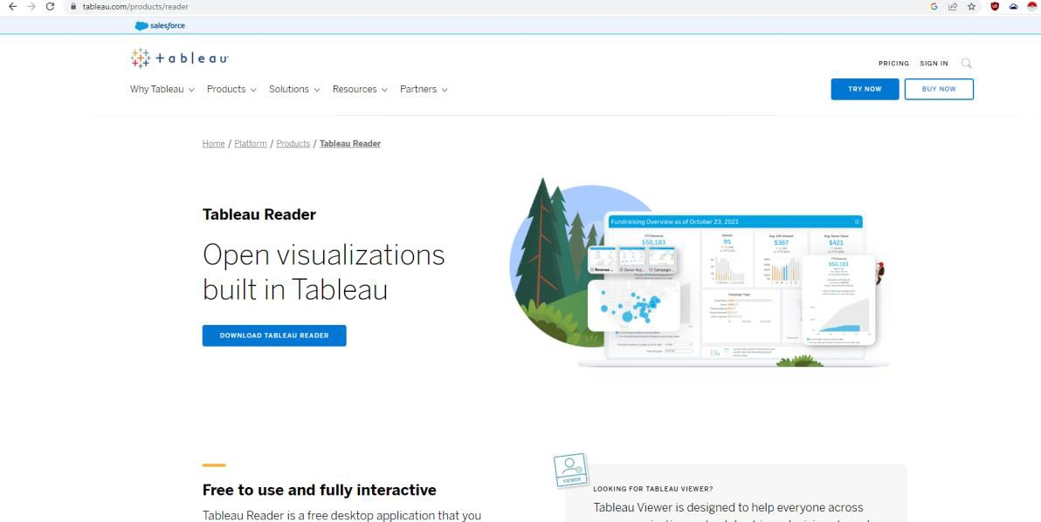
How to use CDP Tableau Dashboards
Installing Tableau Reader
Tableau Reader is all you need to access and use our Tableau data products
Free software
Tableau Reader can be downloaded here: https://www.tableau.com/products/reader

Slide 8
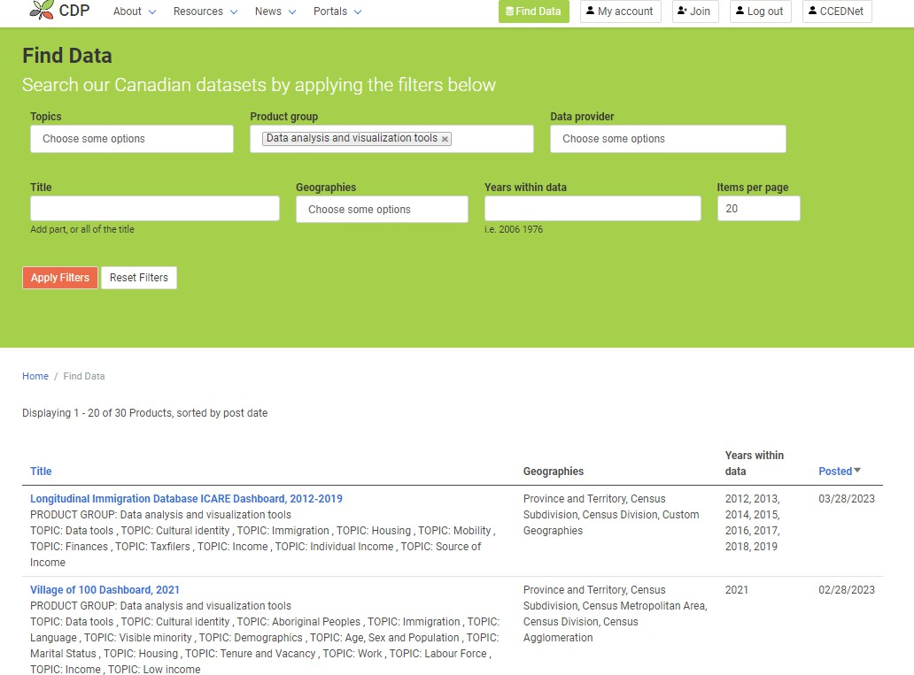
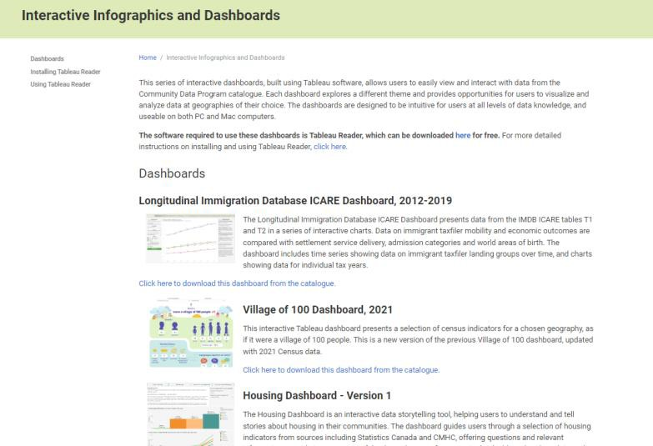
How to use CDP Tableau Dashboards
Finding Tableau dashboards in the CDP catalogue
There are currently over 40 dashboards available to CDP users
To find dashboards:
Interactive Infographics and Dashboards Portal
Catalogue – Data analysis and visualization tools product group
Dashboards are all in Packaged Workbook (.twbx) format, openable in Tableau Reader

Slide 9
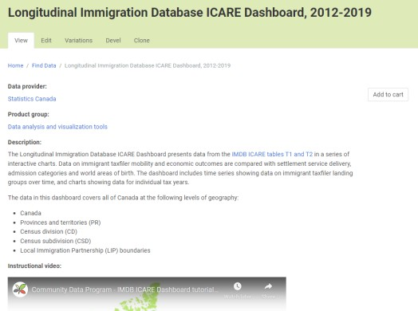
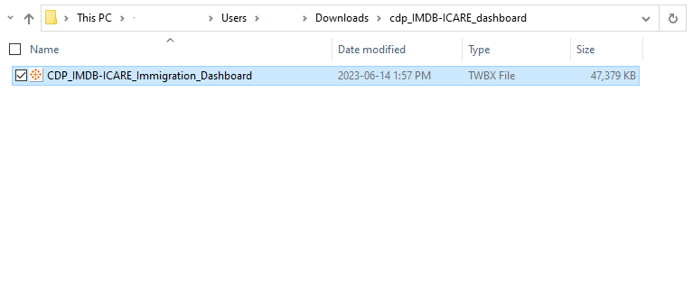
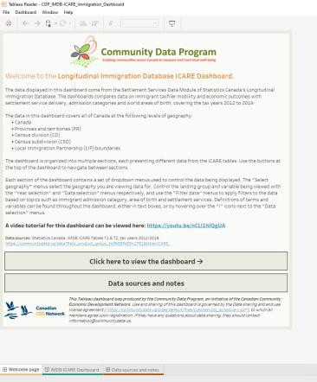
How to use CDP Tableau Dashboards
Opening Tableau Packaged Workbooks
Install Tableau Reader
Find and download a dashboard from the CDP catalogue
Same steps as downloading any other data product
Unzip the .zip file that is downloaded containing the packaged workbook file
Double-click to open the packaged workbook file in Reader OR open Tableau Reader, click File > Open and select the packaged workbook file

Slide 10
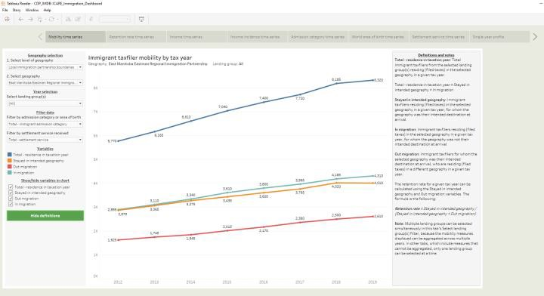
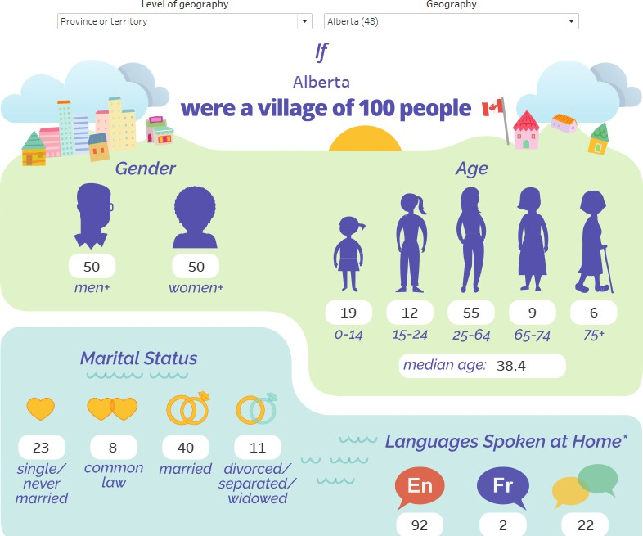
How to use CDP Tableau Dashboards
Using Tableau dashboards
The instructions vary by dashboard
Dashboards contain instruction and are designed to be intuitive to use
Select geographies and apply filters
Most dashboards contain a welcome page and links to data sources
If you have specific questions, email us at information@communitydata.ca

Slide 11
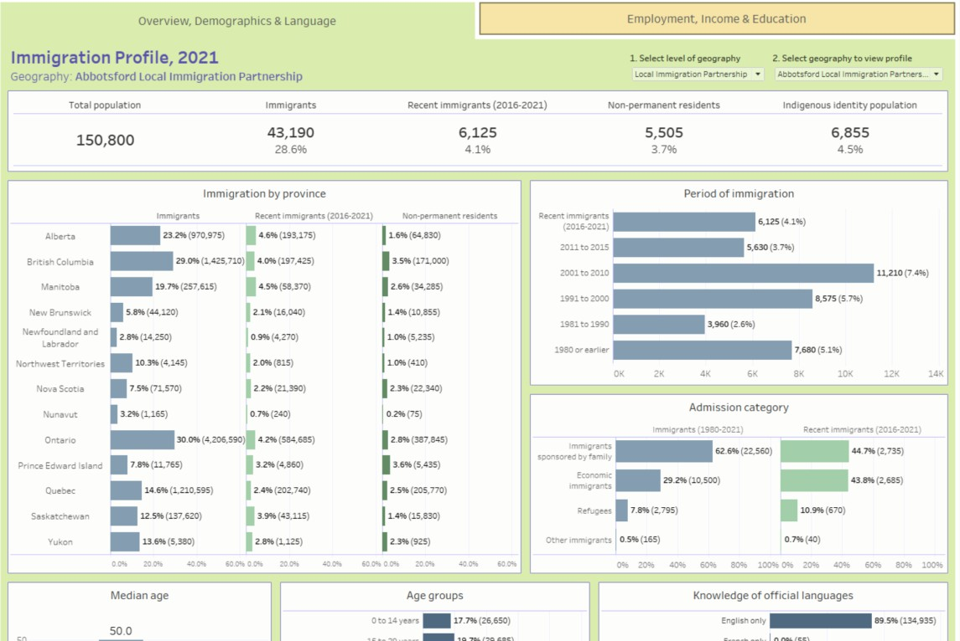
Demo: Immigration Profile Dashboard, 2021
Infographic style dashboard
Displays immigration-related variables for a selected community

Slide 12
Demo: Community Recovery Dashboard V4
Themed dashboard
Interactive mapping and charts for comparison across geographies
Filters for selecting data to display

Slide 13
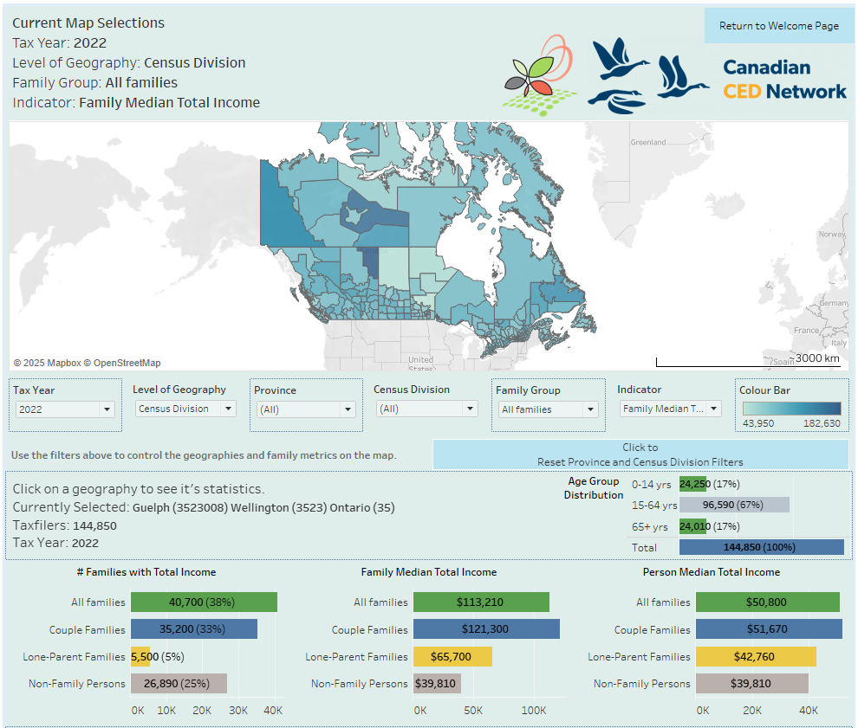
Demo: Taxfiler F-01
Infographic dashboard with interactive mapping
Displays data from 2019-2022

Slide 14
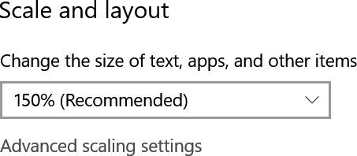
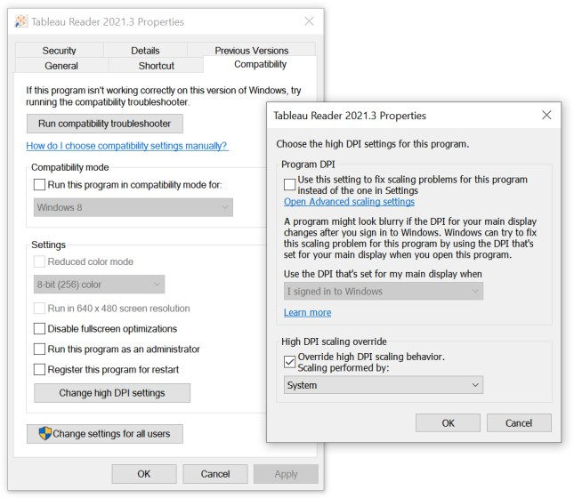
How to use CDP Tableau Dashboards
Common questions and issues
Text in dashboards appears too large or is cut off
Adjust scaling setting to “100%” when using Tableau
Reader
Found in Windows “Display” settings under “Scale and Layout”
OR in some cases this can be fixed permanently in the Tableau Reader Windows properties (right-click the Tableau Reader shortcut in Windows and click “Properties”)
Go to “Compatibility” > “Change high DPI settings” then checking the box for “Override high DPI scaling behavior”
Select “System” for “Scaling performed by:” setting
If this does not work, unchecking “Override high DPI scaling
behavior” will return everything to normal

Slide 15
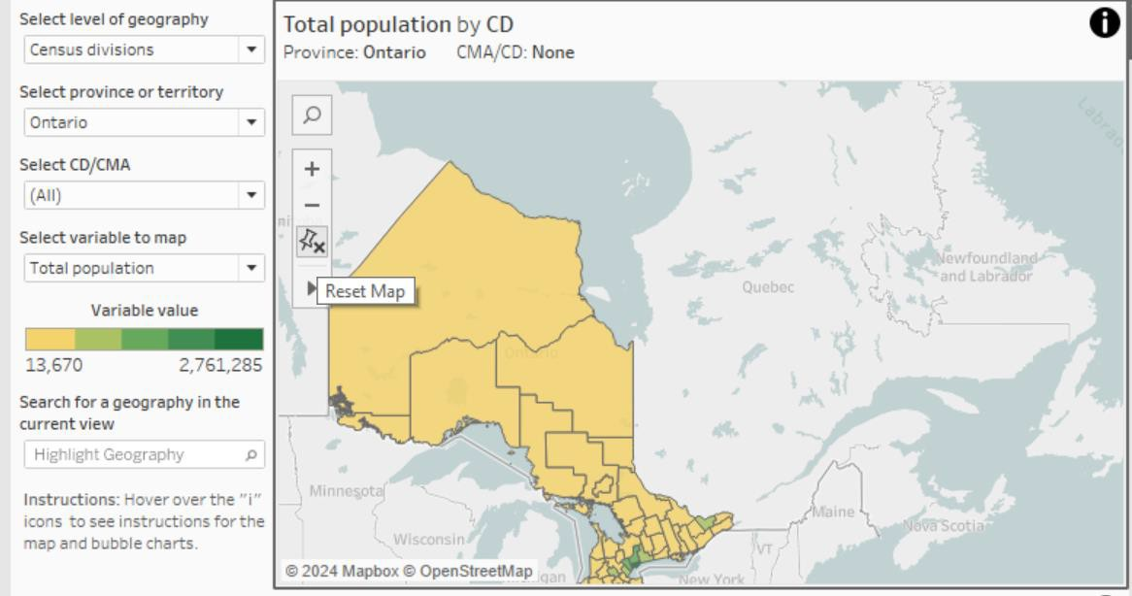
How to use CDP Tableau Dashboards
Common questions and issues
The map doesn’t update when changing provinces or levels of geography
The map needs to be in the “reset” position to update when changing geographies
If you have moved the map, press the “Reset Map” button (pin icon) before or after changing geography filters to zoom to the new geographies automatically

Slide 16
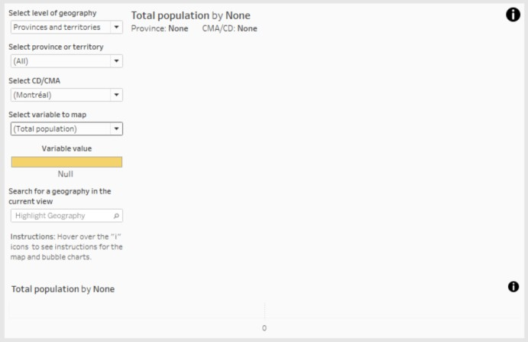
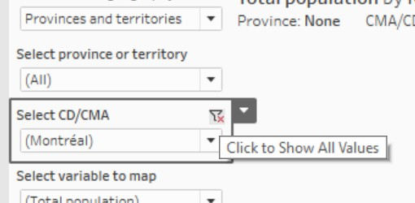
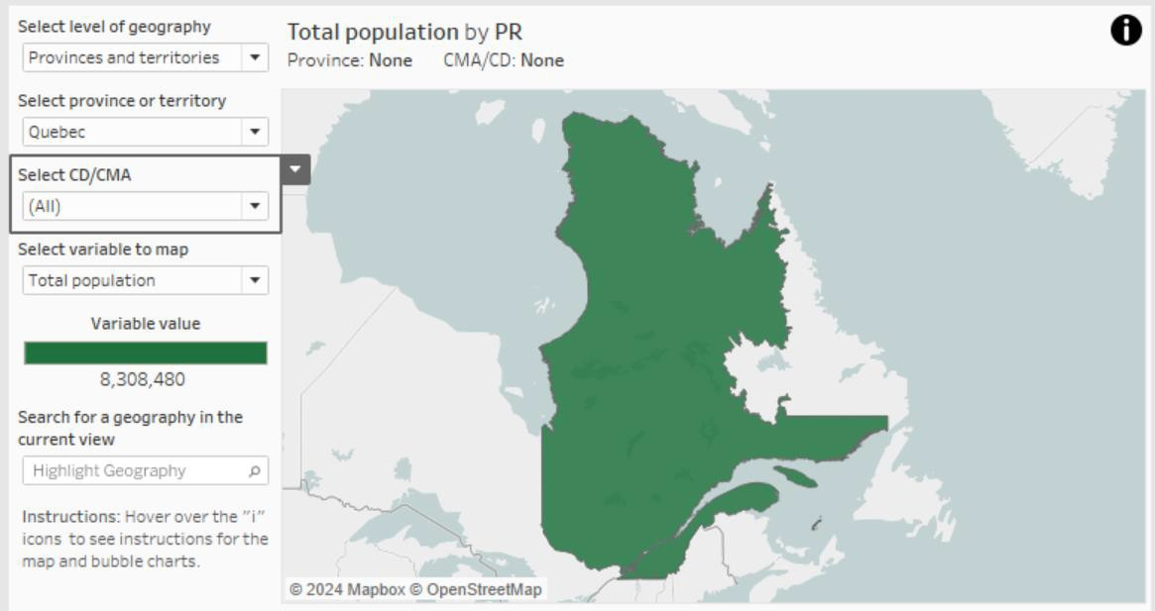
How to use CDP Tableau Dashboards
Common questions and issues
The map display disappears when changing geography filters
Set the “Select region” or “Select CD/CMA” filters to “(All)” (or click the “Click to show all values” button) and the geographies should reappear
If they do not reappear, then set “Select province or territory” to “(All)” as well and that will fix the issue
This happens when you have filtered out all geographies with your filter selection

Slide 17
Thank you!
Questions?
If you have any questions about our dashboards, you can email us at information@communitydata.ca

