Slide 1
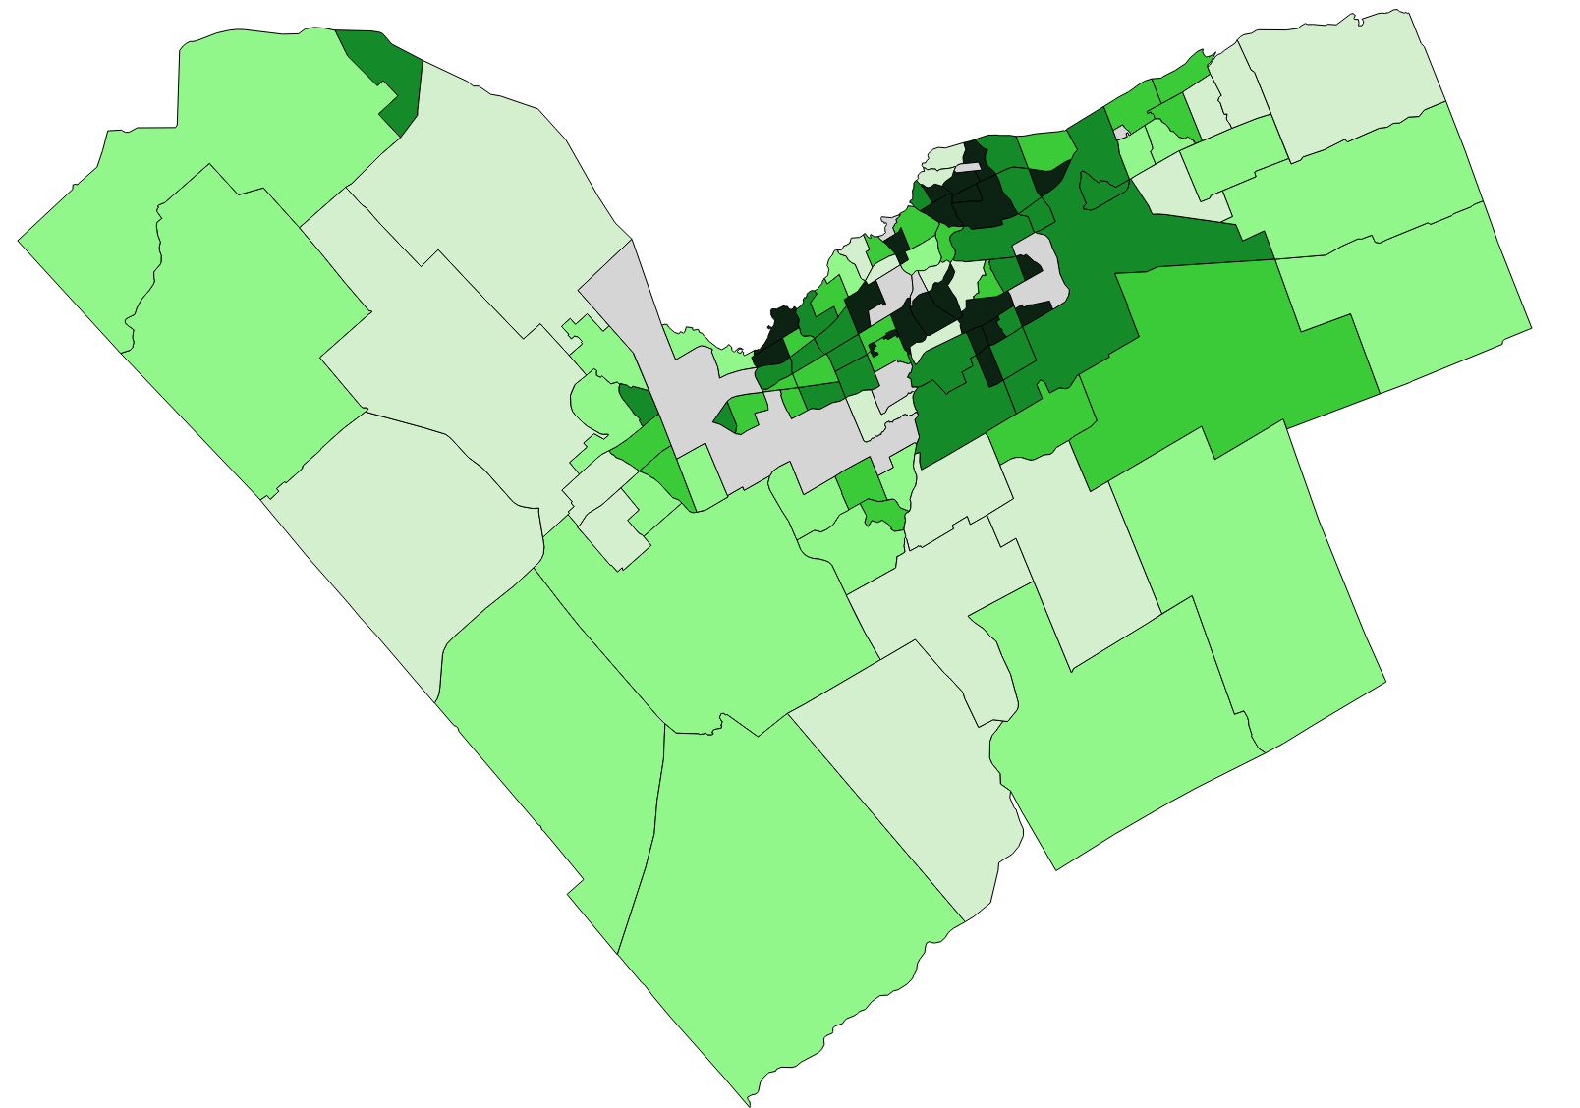
The Ottawa Neighbourhood Study: Developing an Interactive Housing Profile using ArcGIS Story Maps
Presented by: Kady Carr Anzo Nguyen
Ottawa Neighbourhood Study (ONS)

Slide 2
Presentation Outline
Introduction to the Ottawa Neighbourhood Study
About the Study, Methodology, Knowledge mobilization
ONS’s housing data project
Integrating housing data from multiple sources
Role of the CDP
Using ArcGIS Story Maps as a tool for data storytelling
Project logistics

Slide 3
What is ONS?
uOttawa-based research program (est. 2006)
Ottawa Neighbourhood Study
Brings together comprehensive neighbourhood-level data in Ottawa
Focus on the determinants of health
Used to inform data-driven decision making in the city
Supports stakeholders in identifying needs, efficiently allocating resources, and advocating for services.
Not for Profit Organization (est. 2021)
Ottawa Neighbourhood Scientific Research Solutions Inc.
Community-driven neighbourhoods
1
Neighbourhood data
2
Research & Analysis
3
KTT & Community partnerships
4

Slide 4
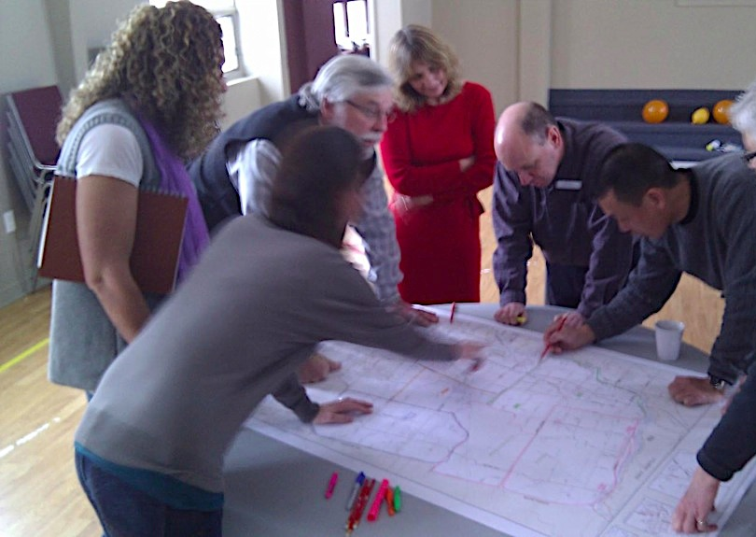
1 Community-driven neighbourhoods
Initial identification of natural/physical boundaries, areas with similar population characteristics
Boundaries drawn in collaboration with the community and service providers
Revised every 5-10 years
Outcome
Local contextual relevance (capture the physical characteristics and social constructs)
Better identification of unique neighbourhood needs (no “dilution” of data)
Encourages community engagement and participation in local planning
Neighbourhoods evolve with the community

Slide 5
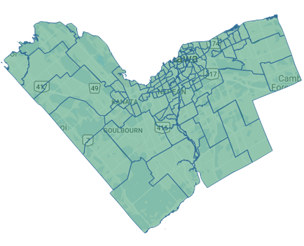
2 Neighbourhood data
Demographic, social, economic, access to services, natural and built environment, health outcomes, crime and safety, walkability, culture, etc.
Paints wholistic picture of communities and their diverse needs, and the resources in the communities
Sources
Statistics Canada (CDP)
City of Ottawa
ICES, OCHPP
OpenStreetMap
Web scraping
Primary data collection
Remote sensing
Machine learning

Slide 6
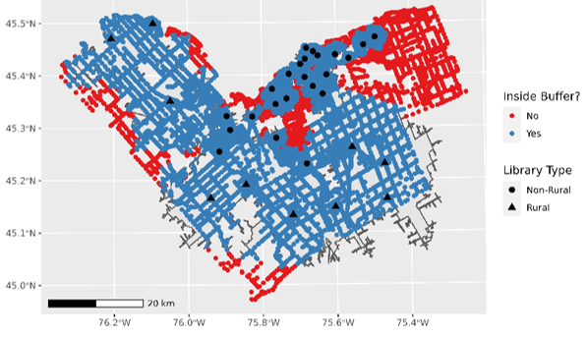
3 Research & Analysis
If facilities are intended to service residents living within a 10-minute walk from them, how many residents are not covered?
Research on the relationship between neighbourhood characteristics, resident demographics, and health and wellbeing outcomes. Identification of inequities
Methods
Statistical Analyses
Composite measures (indices)
Geospatial analyses
Machine learning techniques
Optimization algorithms
Covered by service area?
Facility type

Slide 7
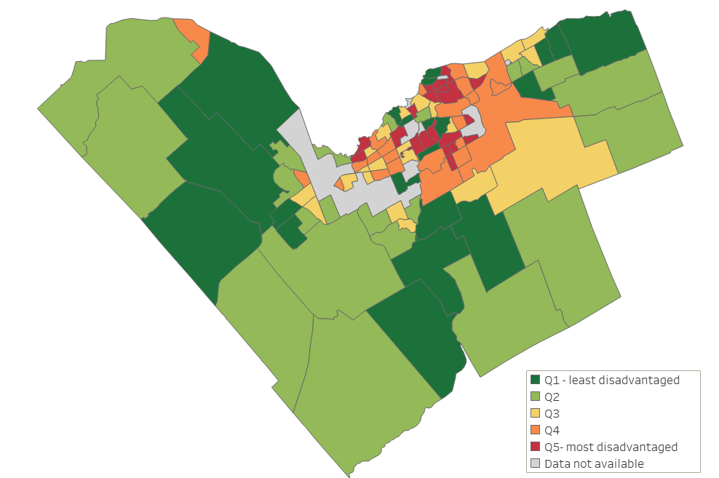
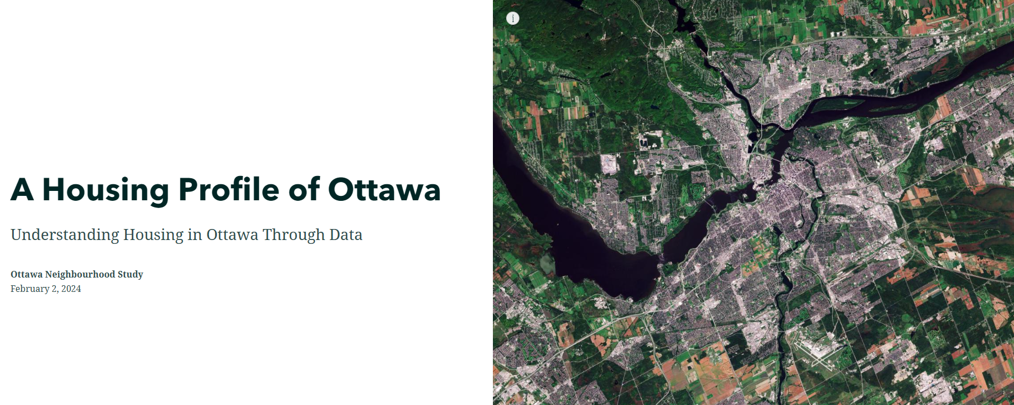
4 KTT & Community partnerships
User-friendly dynamic maps on neighbourhoodstudy.ca
Tableau, PowerBI, infographics, storymaps
Ongoing collaborations with stakeholders and community partners to guide research and dissemination
Partnerships built over 15+ years in the community, adoption of neighbourhoods

Slide 8
ONS’s Housing Project and Story Map
PI: Dr. Claire Kendall

Slide 9
What we found
What we did
Homelessness and shelter use
Homelessness and shelter use
Housing costs (property prices, rents, mortgages, etc.)
Housing costs (property prices, rents, mortgages, etc.)
Core housing need (affordability, suitability, adequacy)
Ottawa’s Housing Landscape
Social and affordable housing data
Demographics and housing
Social and affordable housing data
Demographics and housing
Housing supply
Housing supply

Slide 10
Project Overview
Identify and Acquire data
Analysis and visualization
Dissemination
-Ottawa Research Data Centre (ORDC), Community Data Program, individual agreements, open access sources
- Draw insights from data into reports, infographics, data storytelling
-Dissemination goal: make the data publicly available and engage broad audiences with data storytelling
Use natural neighbourhoods whenever possible

Slide 11
Data Used in the Project
Statistics Canada
TransUnion
-2021 Census
-Canadian Housing Statistics Program
-Canadian Housing Survey
-Mortgage debt data
Housing Profile of Ottawa
-Story Map
-Indicators on ONS website
City of Ottawa
Canada Mortgage and Housing Corporation (CMHC)
-Point in Time Count of Homelessness
-Homeless Individuals and Families Information System (HIFIS)
-Social and Affordable housing waitlist
Other sources
-Starts and Completions Survey
-Rental Market Survey
-Geospatial analysis of greenspace and proximity to amenities
-Location data of services, amenities
-Rental data scraping from Kijiji, PadMapper, Rentals.ca, MLS listings

Slide 12
Role of the CDP
2021 Census Profile by ONS neighbourhood
2021 Census Target Group Profiles for:
Indigenous
Visible minority
Age groups (e.g., 65+ years)
Living in low-income
Newcomers to Canada
Community Data Program
Ottawa Neighbourhood Study
TransUnion mortgage debt data by postal code (can link to neighbourhoods)

Slide 13
Collaborating with an Advisory Group
Bruyère Research Institute
Housing Help/Action Logement
City of Ottawa
Advisory group
Domain expertise
Collaboration, advice, feedback
Inter-organizational connections
United Way East Ontario
Alliance to End Homelessness Ottawa
Community Navigation Eastern Ontario
Social Planning Council of Ottawa
University of Ottawa
Coalition of Community Health and Resource Centres of Ottawa (CCHRC)
City for All Women Initiative

Slide 14
How to disseminate all this data?
We needed a way to…
Reach a broad audience
Combine different types of visuals (e.g., maps, graphs, images)
Create an immersive, engaging experience
Include both big-picture highlights and the details
The solution…ArcGIS Story Maps

Slide 15
ArcGIS Story Maps
Proprietary software by Esri
Application to create immersive, map-based narratives online
Integrates text and embedded maps, images, graphs, dashboards

Slide 16
ArcGIS Story Maps
Maps made in
ArcGIS Pro, ArcGIS Online
Accompanying text written directly in Story Maps
Infographics made in PowerPoint
Housing Story Map
Graphs and dashboards made in Tableau
Links to dashboards hosted externally @ City of Ottawa

Slide 17
ArcGIS Story Maps: Pros and Cons
Pros | Cons
Immersive data storytelling for general audiences Can communicate both large volumes of data and just the highlights User-friendly interface, small learning curve | Inflexible formatting and screen size options Difficult to embed a story map onto another website Lack of built-in version control

Slide 18
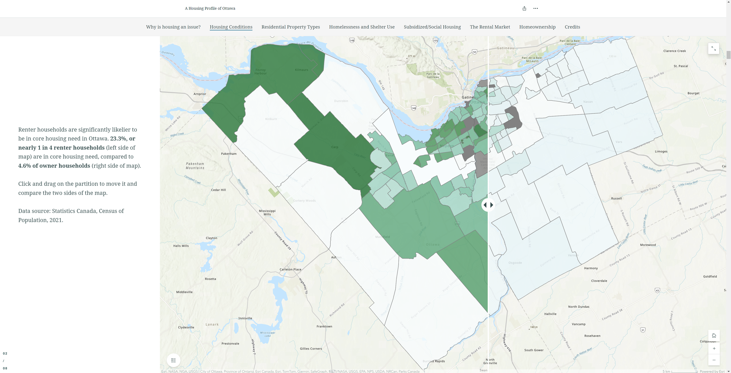
ArcGIS Story Maps
Click here to view the story map!

Slide 19
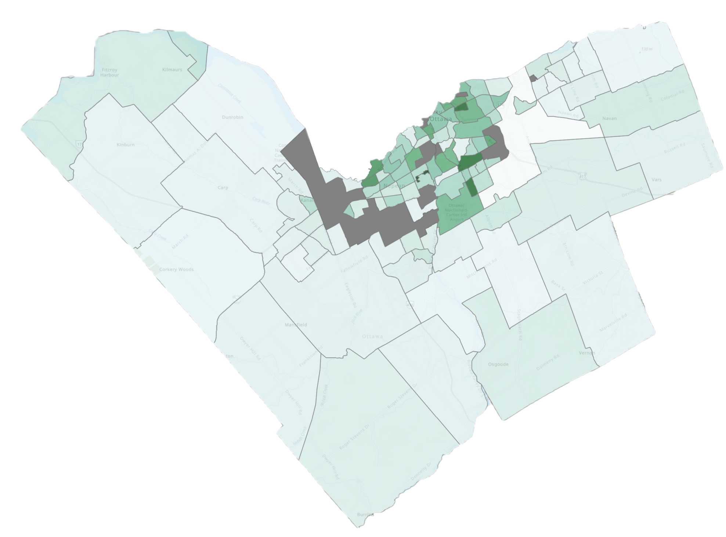
Data Example: Core Housing Need
11.2% of Ottawa households live in core housing need
Renter households more likely than owner households
Source: Statistics Canada, Census of Population, 2021

Slide 20
Data Example: Affordability
In Ottawa, core housing need is driven by unaffordability
2021 Census – median monthly shelter costs for…
Owner households: $1,560
Renter households: $1,380
Source: Statistics Canada, Census of Population, 2021

Slide 21
Data Example: Scraping the Rental Market
Rental market scraping (Dec. 2022-Apr. 2023) shows more recent trends in rental prices and availability
Recent rental market conditions differ greatly than Census data
Median monthly rental shelter costs (2021 Census):
$1,380
Source: data scraped from Kijiji, PadMapper, Rentals.ca, MLS listings

Slide 22
Project Logistics
Project length:
~1.5 years
(ongoing updates of housing data)
Project team size:
0.5-1 FTEs
Project budget:
$100,000 from CIHR grant + in-kind contributions from partners

Slide 23
Project Logistics
Some expenses may include…
ArcGIS Pro license = $1,450/year
ArcGIS Story Maps license = $950/year
Tableau license = $75 USD per user/month
Data access costs: microdata access, data agreements, consortium memberships, etc.
Conferences, posters, dissemination

Slide 24
Project Results
ONS Website
Housing Story Map
Integrated data from many different sources using neighbourhoods as a geographic reference point
Developed online resources to better understand the housing landscape of Ottawa and its neighbourhoods
These resources will inform decision-makers in Ottawa for improved housing policy and practice

Slide 25
Thank you!
We would love to hear from you:
anguy146@uottawa.ca
kcarr@uottawa.ca

