Slide 1
Centre for Municipal and Local Data, Statistics Canada
June 27, 2023

Slide 2
Table of contents
FCM-StatCan collaboration
Goals and objectives
Data hub demo
Financial dashboard demo
Working with municipalities

Slide 3
A collaboration between StatCan and FCM
A municipal data program began in 2020 as four small project initiatives
Partnered with the Federation of Canadian Municipalities to highlight data priorities
In 2022 the project grew into a larger 4 year initiative, as part of the Disaggregated Data Action Plan at Statistics Canada
The team consists of economists / analysts, data scientists, standards specialists, regional engagement and communications staff.

Slide 4
Goals and objectives
Gradually improve access to municipal data
Create a one stop shop for city data
Highlight data available
Ease the searching of available and upcoming data
Create analytical outputs to benefit municipal employees, analysts, and citizens
Empower municipalities with their own data
Host training sessions
Collaborate on processing and analysing data
Build tools for municipalities
Increase the amount of municipal data published by Statistics Canada
Highlight data needs to divisions on behalf of municipalities

Slide 5
Key Deliverables for 2023-24
Spring
Standards for Municipalities website (published in April 2023)
Quality of Life dashboard at the municipal (CSD) level
Summer
Diversity of citizens dashboard applying the Diversity framework (all CSDs)
Fall
Data release for financial data (Daily and 2 CODR tables)
Financial dashboard updated, removing CMA data, focusing on financial analysis
Winter
Hub update (January - March)
Plan for annual financial data release
Demography dashboard, more general data on Citizens (all CSDs)
Financial data edited for 2019 and 2020 (for municipalities currently available in the dashboard)
Yearly dwelling count by CSD *potential, currently in discussions with the Demography team
Page to host multiple municipal data dashboards
Notes:
Daniel/Anik: 5 mn

Slide 6
Demo – Municipal Data Hub
The Centre for Municipal and Local Data –
Notes:
EN: Centre for Municipal and Local Data (statcan.gc.ca)
FR: Centre de données municipales et locales (statcan.gc.ca)

Slide 7
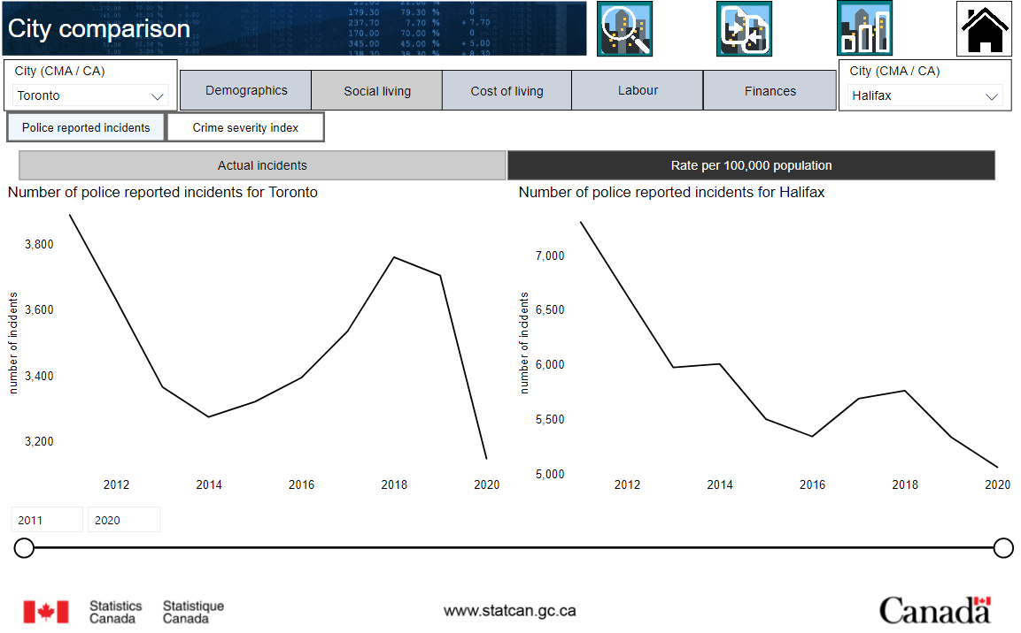
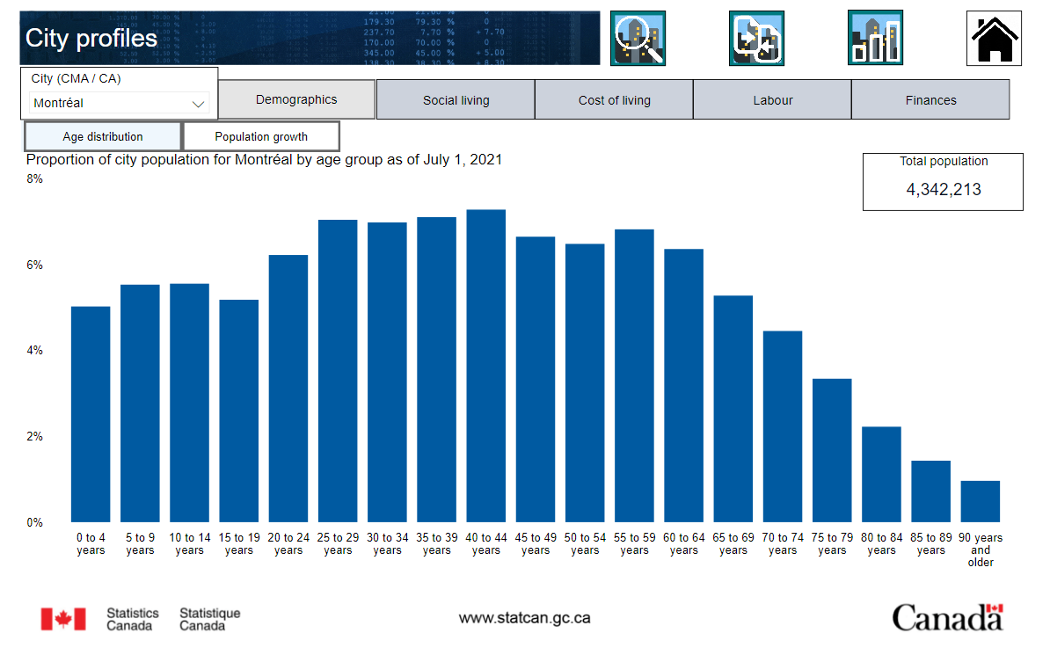
Demo – Municipal Financial and Socioeconomic Data Dashboard
The dashboard -
Notes:
EN: Municipal Financial and Socioeconomic Data Dashboard (statcan.gc.ca)
FR: Tableau de bord des données financières et socioéconomiques municipales (statcan.gc.ca)

Slide 8
Working with municipalities
Help us identify data gaps – What are your data priorities, which datasets are you currently using, can cities provide data via open data.
We may have pilot projects in the future which require working with a handful of municipalities to evaluate if reporting certain data is feasible.
What type of analytical outputs are most useful for your needs

Slide 9
Thank you
Daniel St-Pierre, Municipal Data Strategy
Statistics Canada
Daniel.St-Pierre@statcan.gc.ca

