Slide 1
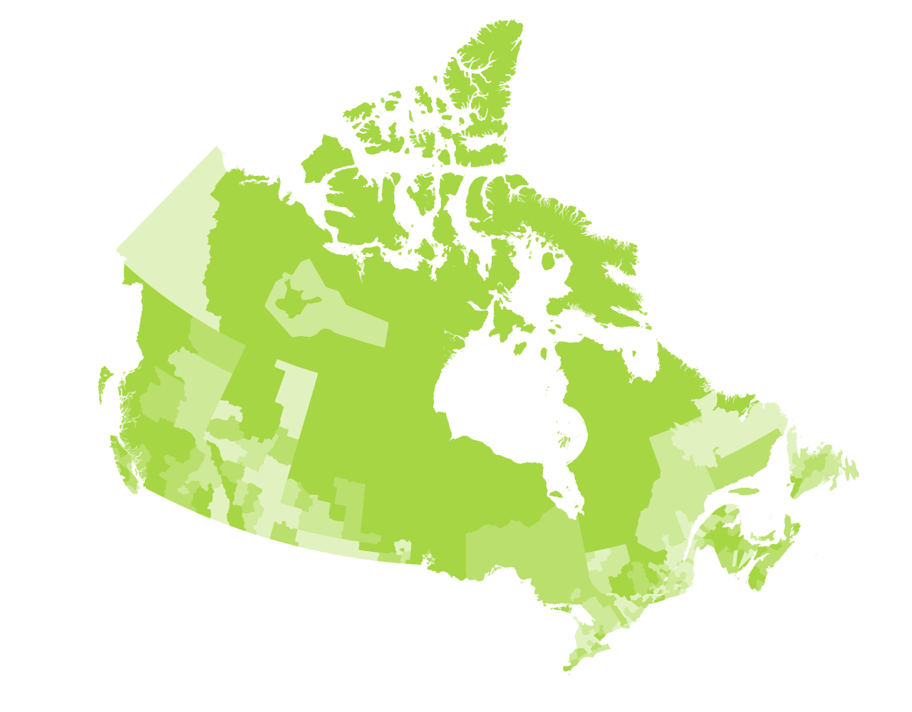
Community Decision Support Tool for Housing Issues
November 16th, 2021

Slide 2
Agenda
Updates and refresher from Solutions Lab Team
Presentation: Doing more with housing data we already have: “work-around” responses to pressing decision-maker questions
Micro-Lab Updates
Please share a few points that can strengthen the prototype from your micro-lab sessions
Breakout Groups
Debrief
Next Steps
Notes:
Workshop Goal: To showcase the four prototypes and clarify role of micro-labs in prototype development.

Slide 3
Updates
Phase 4: October – December 2021
Test and refine Phase 3 prototype for new data sets, indicators, communication tools, and stories with user audience
Update on engagement with CMHC and Statistics Canada

Slide 4
Timeline
2 Mar. 2021
National Insight Generation Workshop
22 Apr. 2021
National level ideation session followed by micro-labs engagement of local stakeholders ideation sessions
15 June 2021
National session to share ideas from local micro-labs & confirm prototyping approach
14 Sep. 2021
Prototyping activities workshop
16 Nov. 2021
Developmental Prototype: V.1 Suite of Tools
14 Dec. 2021
Developmental Prototype: V.2 Suite of Tools
8 Feb. 2022
Lessons Learned Roundtable / Road map engagement session
8 Mar. 2022
Sharing project results and transition to post-project implementation

Slide 5
Objectives of today’s session
Provide an opportunity for participants to ask questions and share feedback on the information package that was distributed October 1st, 2021.
Share presentation on housing indicators with case example from New Brunswick and PEI

Slide 6
Prototype Development – 5 Key Building Blocks
5
Business model
1
Data Access
& Visualization
Community Decision Support Tool for Housing Issues
4
Data Advocacy
2
Housing Data Resources
Engagement & Outreach
3

Slide 7
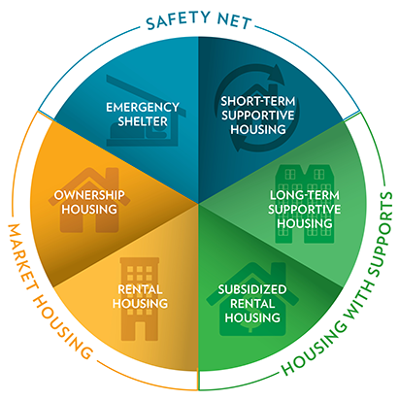
Wheelhouse Model for Organizing Data
Source: https://www.cmhc-schl.gc.ca/en/blog/2019-housing-observer/wheelhouse-new-way-looking-housing-needs
Notes:
- John to add more context

Slide 8
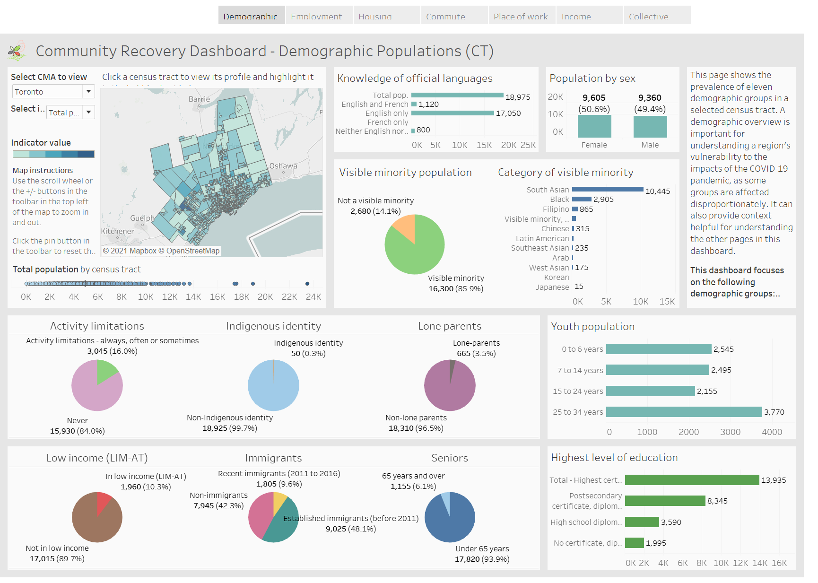
Data Visualization
Dashboard
Infographic

Slide 9
Doing more with housing data we already have: “work-around” responses to pressing decision-maker questions
Presented by David Crenna, PhD

Slide 10
Update from micro-labs
Please share a few points that can strengthen the prototype that were discussed during your micro-lab sessions.
Micro-Labs
Halton
Winnipeg
Toronto
Quebec

Slide 11
Breakout Groups

Slide 12
Breakout Groups
Group 1 – hosted by Mike Ditor:
Data Access & Visualization
Group 2 – hosted by John Purkis and David Crenna:
Engagement & Outreach
Housing Data Resources
Data Advocacy
Business Model

Slide 13
Mural Board
Link to Mural Board

Slide 14
Debrief

Slide 15
Next Steps
Review feedback from today’s session
Next Session: December 14, 2021 – present revised prototype based on feedback

Slide 16
Timeline
2 Mar. 2021
National Insight Generation Workshop
22 Apr. 2021
National level ideation session followed by micro-labs engagement of local stakeholders ideation sessions
15 June 2021
National session to share ideas from local micro-labs & confirm prototyping approach
14 Sep. 2021
Prototyping activities workshop
16 Nov. 2021
Developmental Prototype: V.1 Suite of Tools
14 Dec. 2021
Developmental Prototype: V.2 Suite of Tools
8 Feb. 2022
Lessons Learned Roundtable / Road map engagement session
8 Mar. 2022
Sharing project results and transition to post-project implementation

